Slide 1
Just imagine
Tactile books for young children
Rannveig Traustadóttir og Ásta Björnsdóttir
rannveig.traustadottir@midstod.is
asta.bjornsdottir@midstod.is

Slide 2
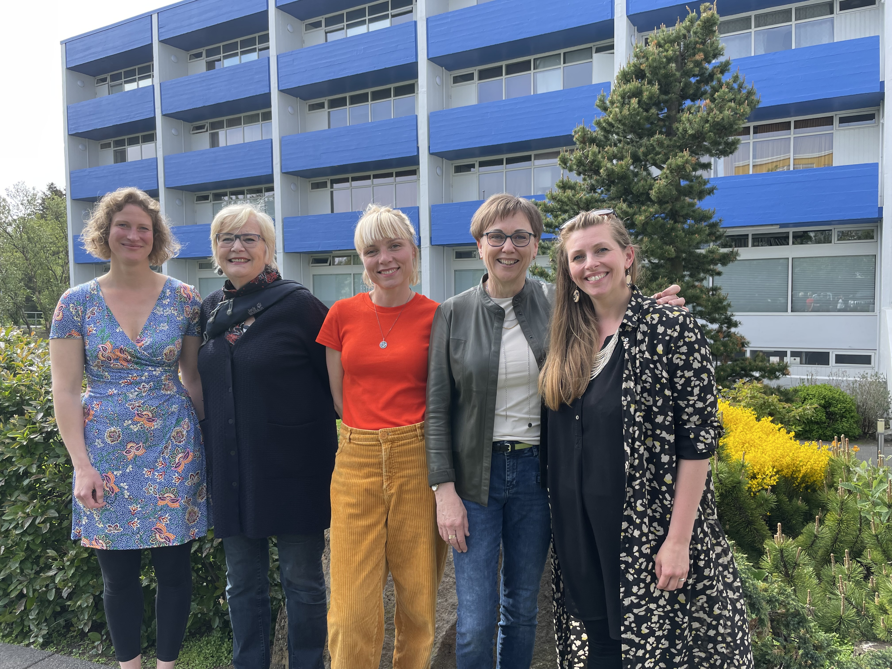
The ladies behind the project

Slide 3
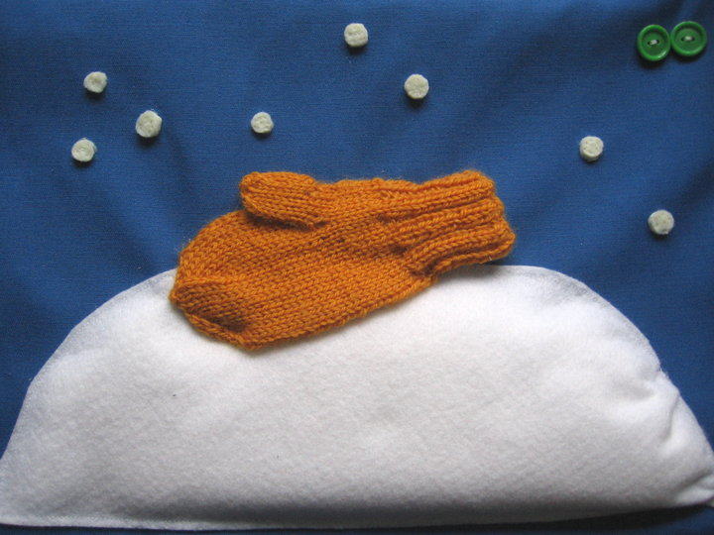
Tactile books
Access to tactile books has not been good through the years, neither in Iceland or other countries in the world.
There have been projects before but now there was an increased need for young children

Slide 4
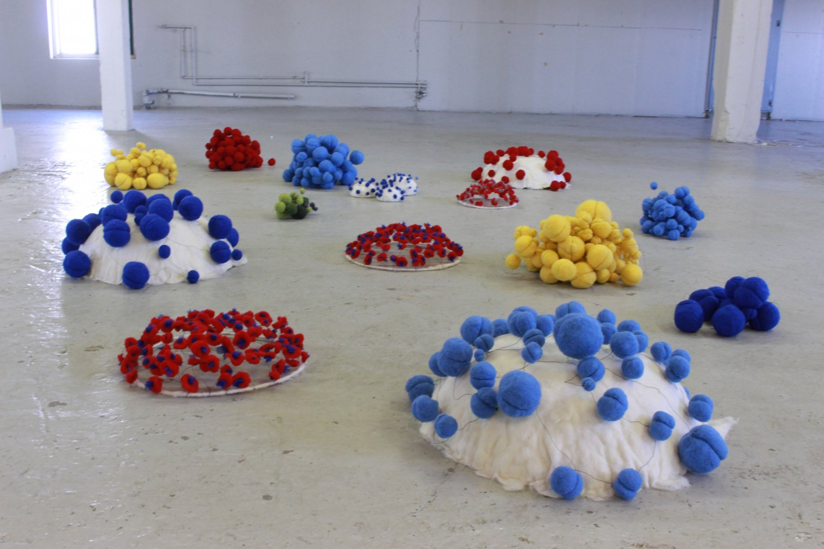
An idea is born
Special educational advisors at the National institute, Sjónstöðin, have great interest to make tactile books
En exhibition by an Icelandic artist Gerður Guðmundsdóttir in 2019 called „Skynjun-má snerta“ „Sensation-touching is allowed“ was a turning point
The new idea was a co-operation with advisors for blind and visually impaired children, a designer and a writer, the Dream team.

Slide 5
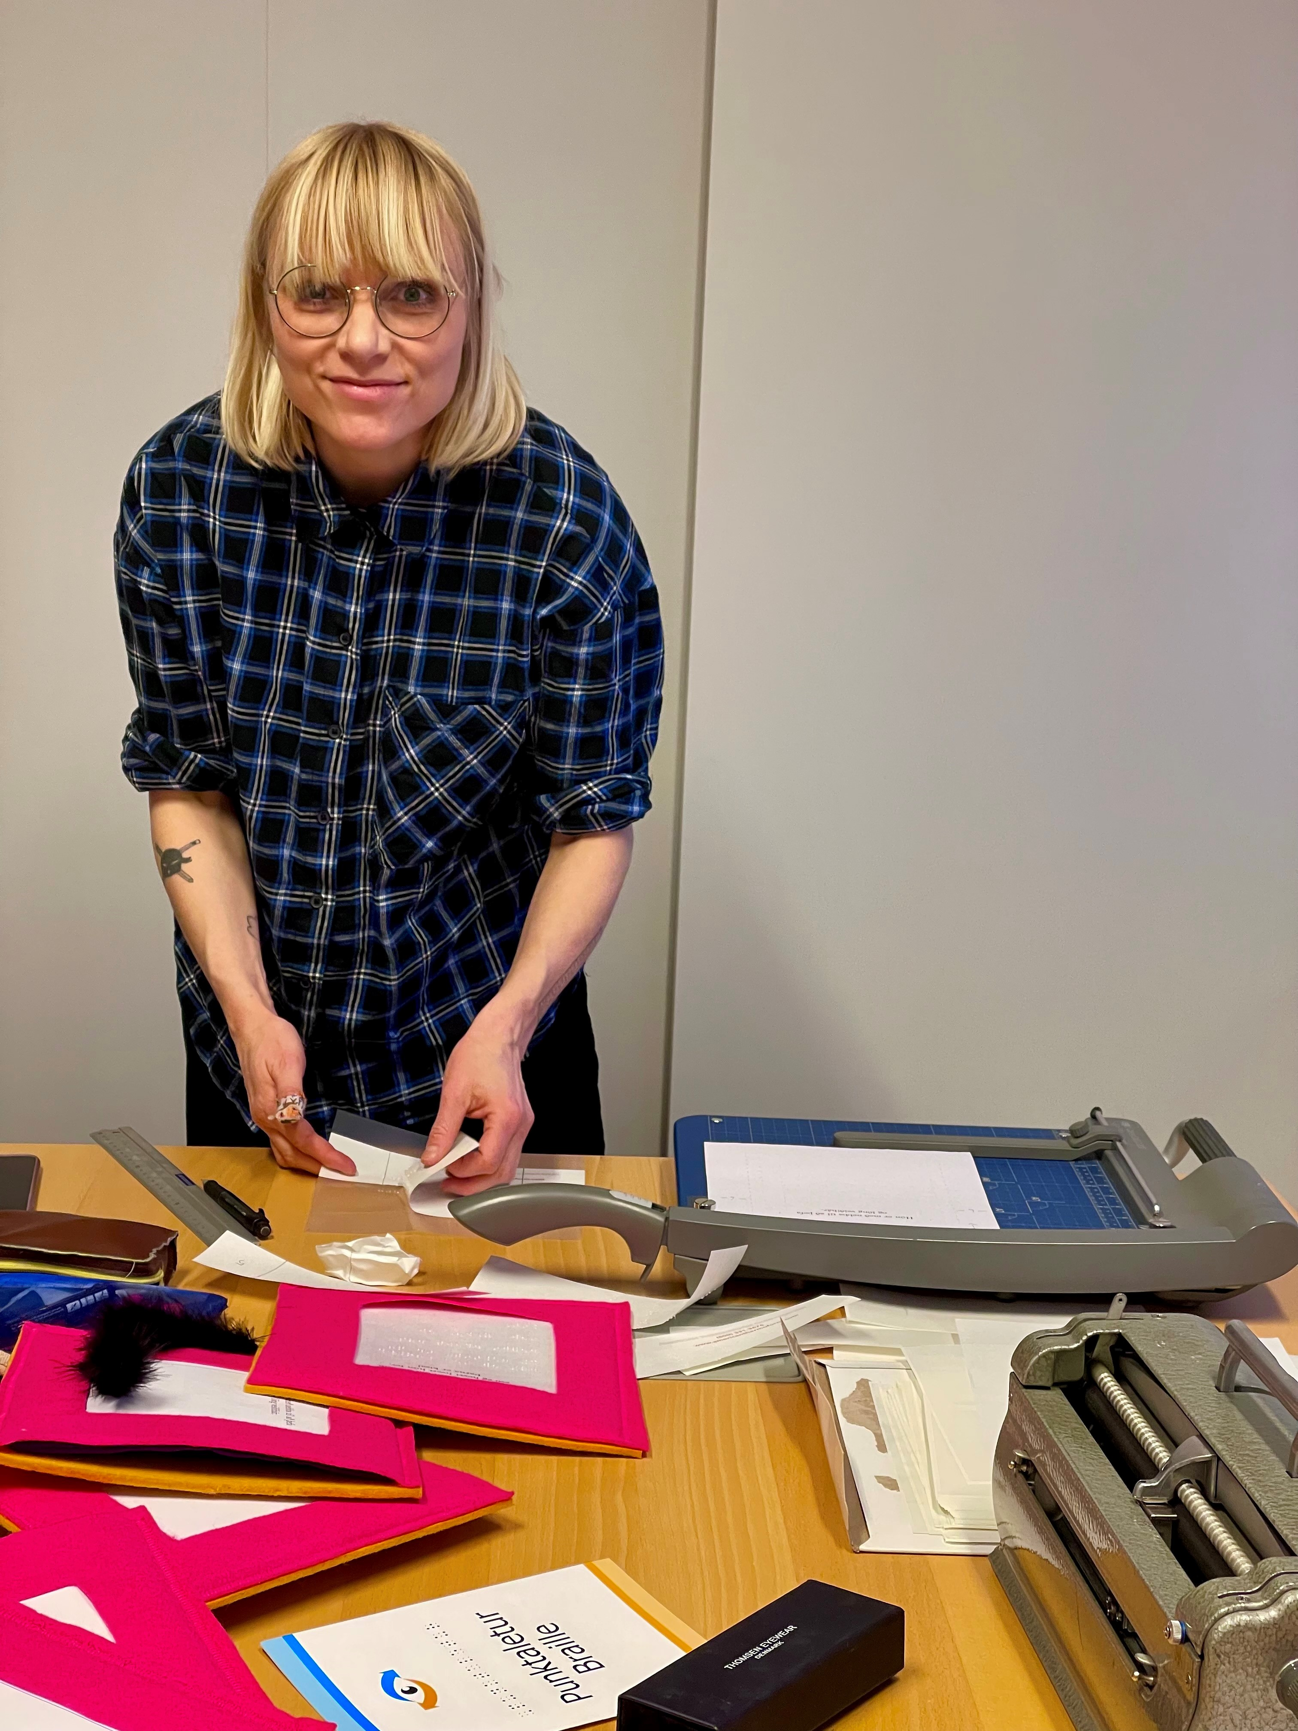
Then what?
Ninna Margrét Þórarinsdóttir a designer and illustrator was interested to do a project with us
We got funding from
The Blind Union in Iceland
Children‘s culture fund of Iceland

Slide 6
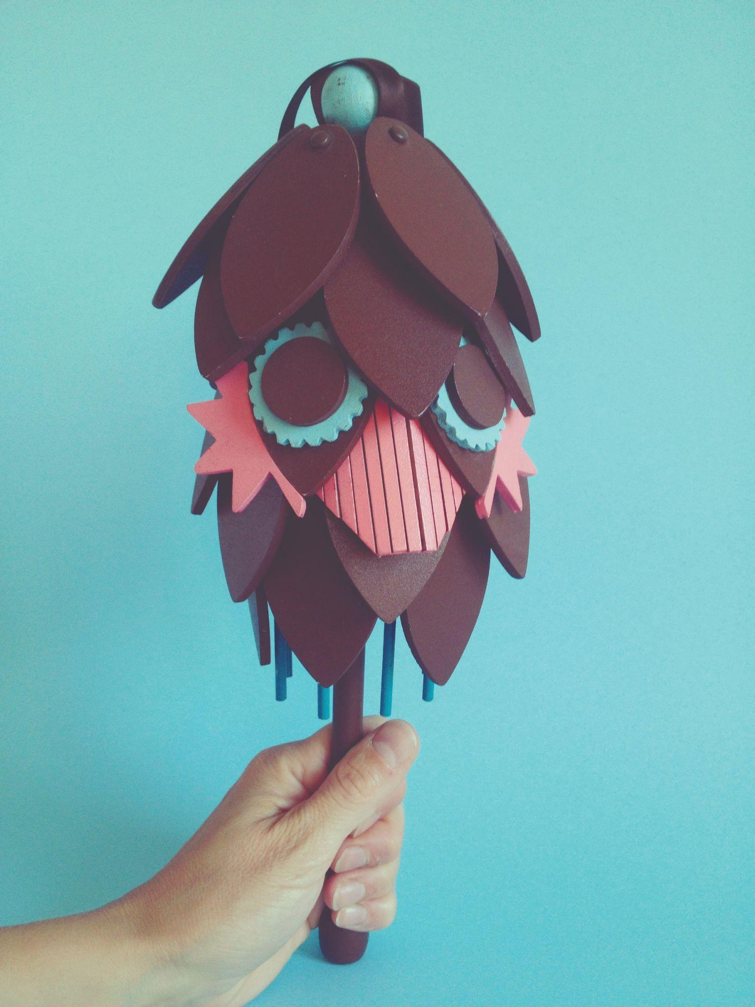
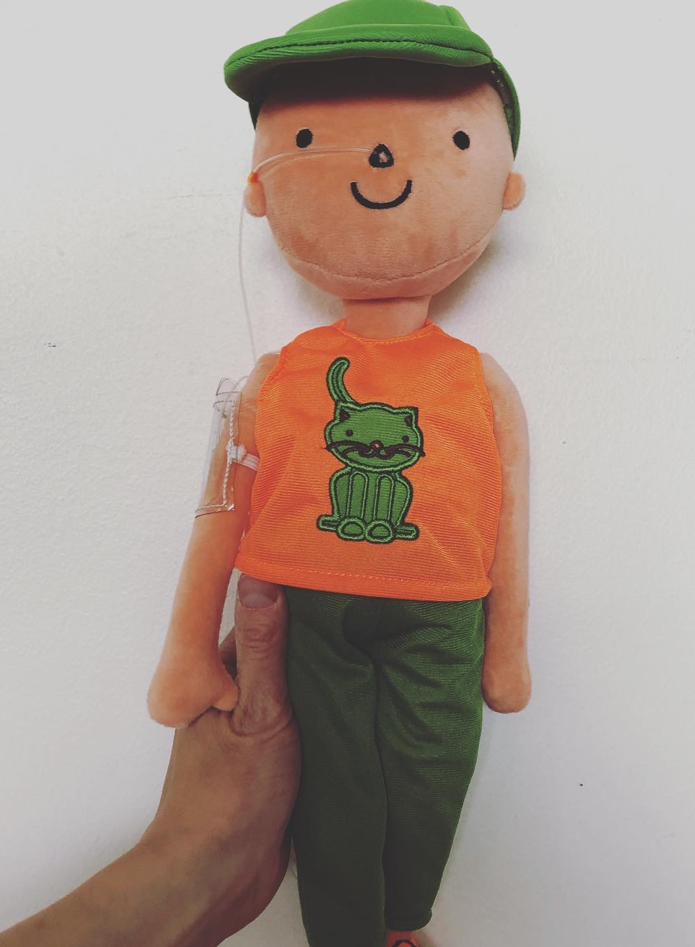
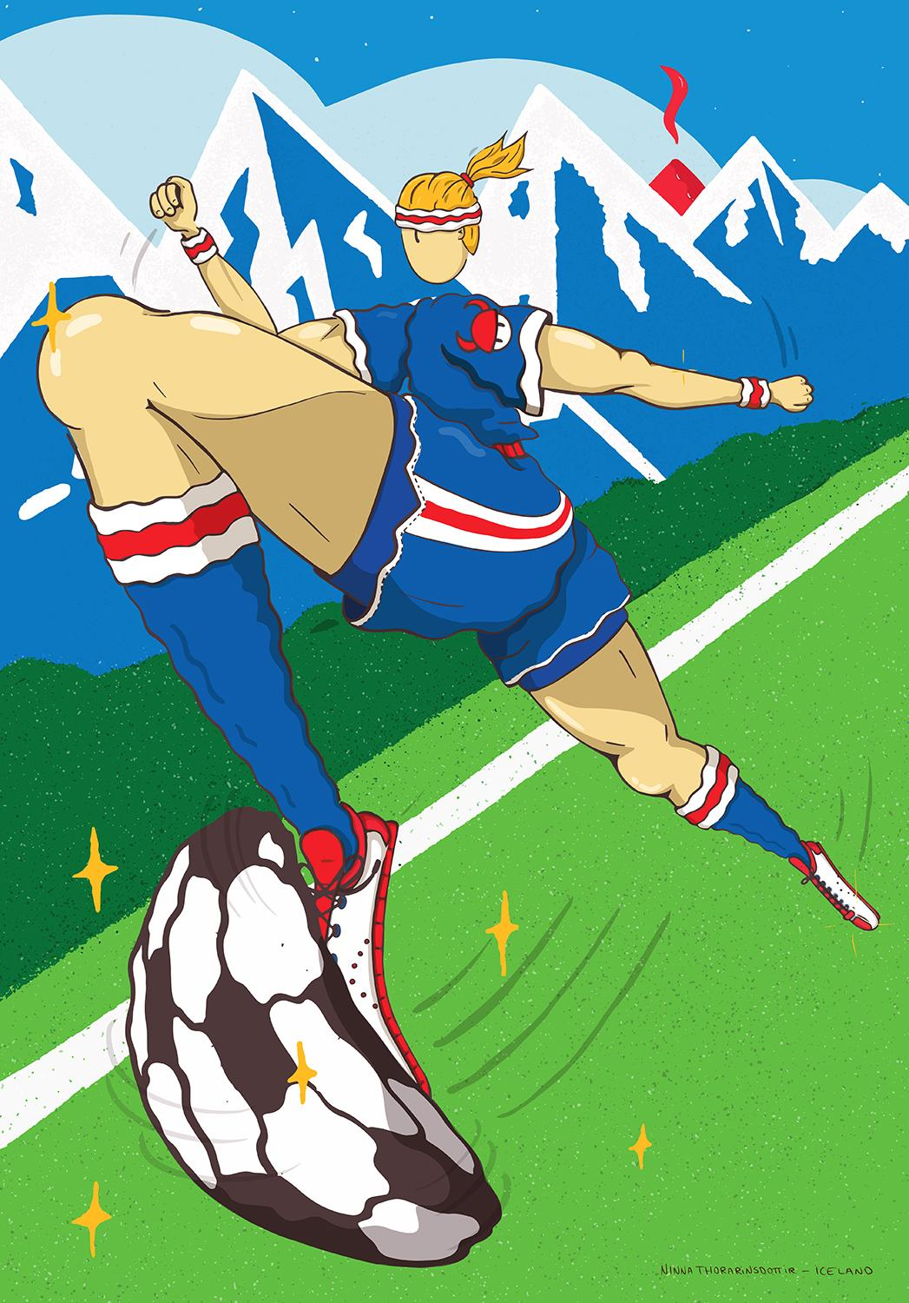
Ninna
Notes:
We want to tell you a little bit about our designer. Ninna has a BA in design, she specialices in drawing and textile (textíl) and has MA in Child culture design. She has a lot of experience and has worked as a textile and graphic designer and illustration. Spring 2020 she came to participate in our project to make tactile books for blind children.

Slide 7
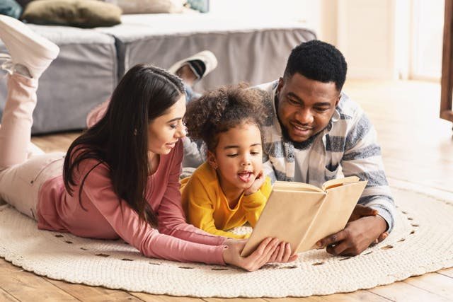
Our goal
Our goal was too work with innovation and interprofessional co-operation between our national institute and artists and designers.
It is our sincere wish that the books will inspire joyful, positive and educational quality time for children, families and shcools.

Slide 8
The books
A series of books for blind children
Four books for children age 0-3 og 3-6 years
Notes:
We made 4 books, 2 for children 0-3 years old and 2 for children 3-6 years old. We will lend them to the children for as long as they like, like with any other equipment at our Institute (like magnifiers and white canes and more. With our project we wanted to give blind children access to fun and interesting books that has been limited for them in Iceland. We feel that it is so important to meet their needs as with varity of books as for children who use vision.

Slide 9
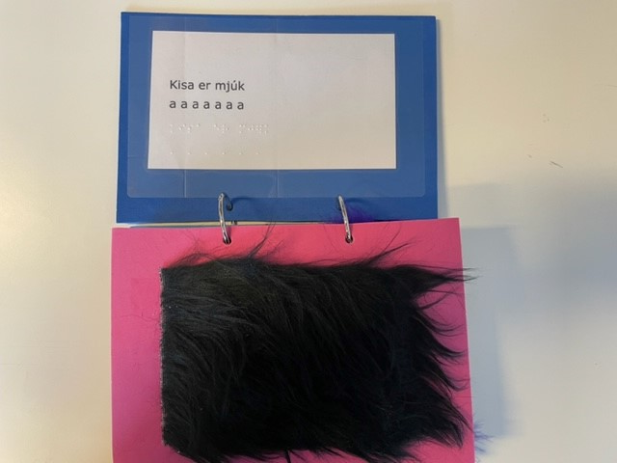
How do you design a tactile book?
How do you design a tactile book and what kind of stories to you write?
Research show that it is important for children to relate and connect to the stories they hear and read. There are a few ways to do it, with real objects and different texture. Our emphasis was that the reader would not need any vision to enjoy the books.
To make a good accessible tactile book there is a lot to consider so the children have the opportunity to understand and interpret pictures, forms and different texture. The books have to be timeless and of great quality for upcoming generations.

Slide 10
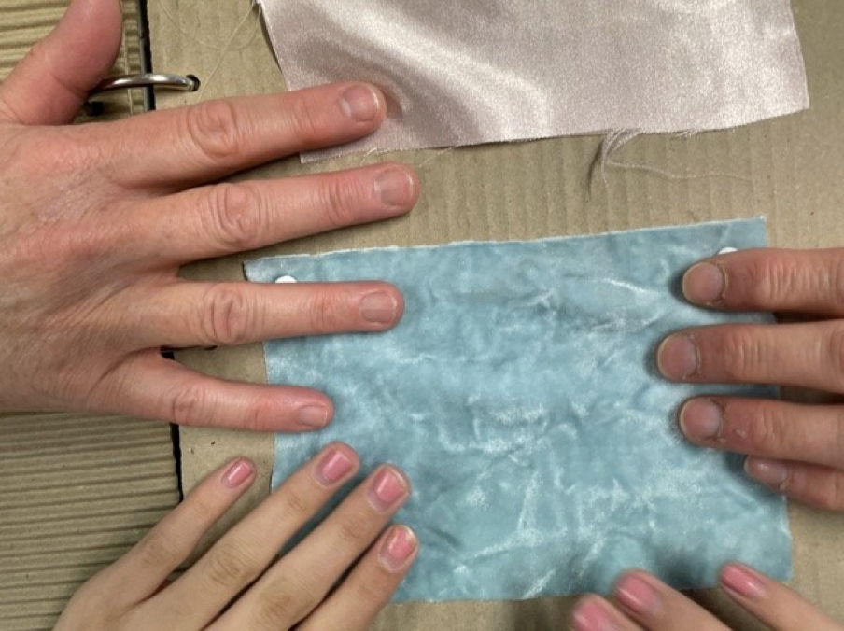
The workprocess
Our project was devided into two parts, the first one was interviews with advisors, blind children and adults about stories and texture and the other part was research about different fabrics and things to use for the right sensations and texture in the books.
And then of course writing the stories and making the books ☺

Slide 11
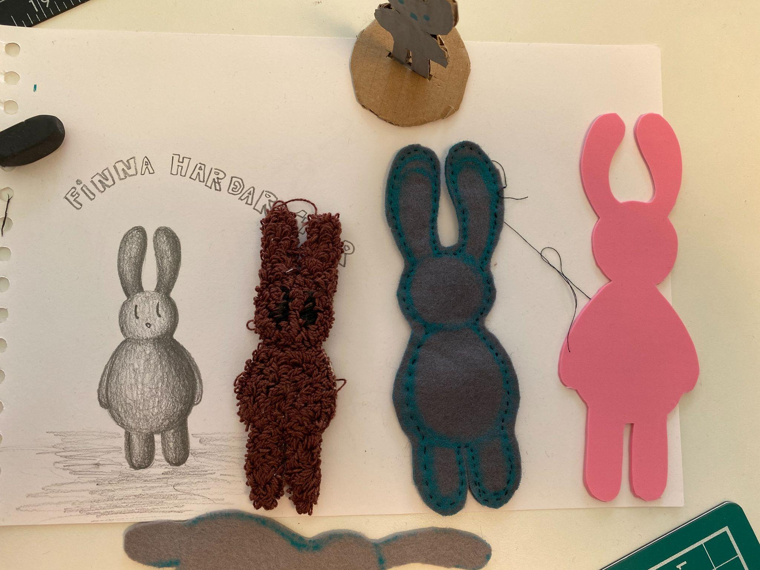
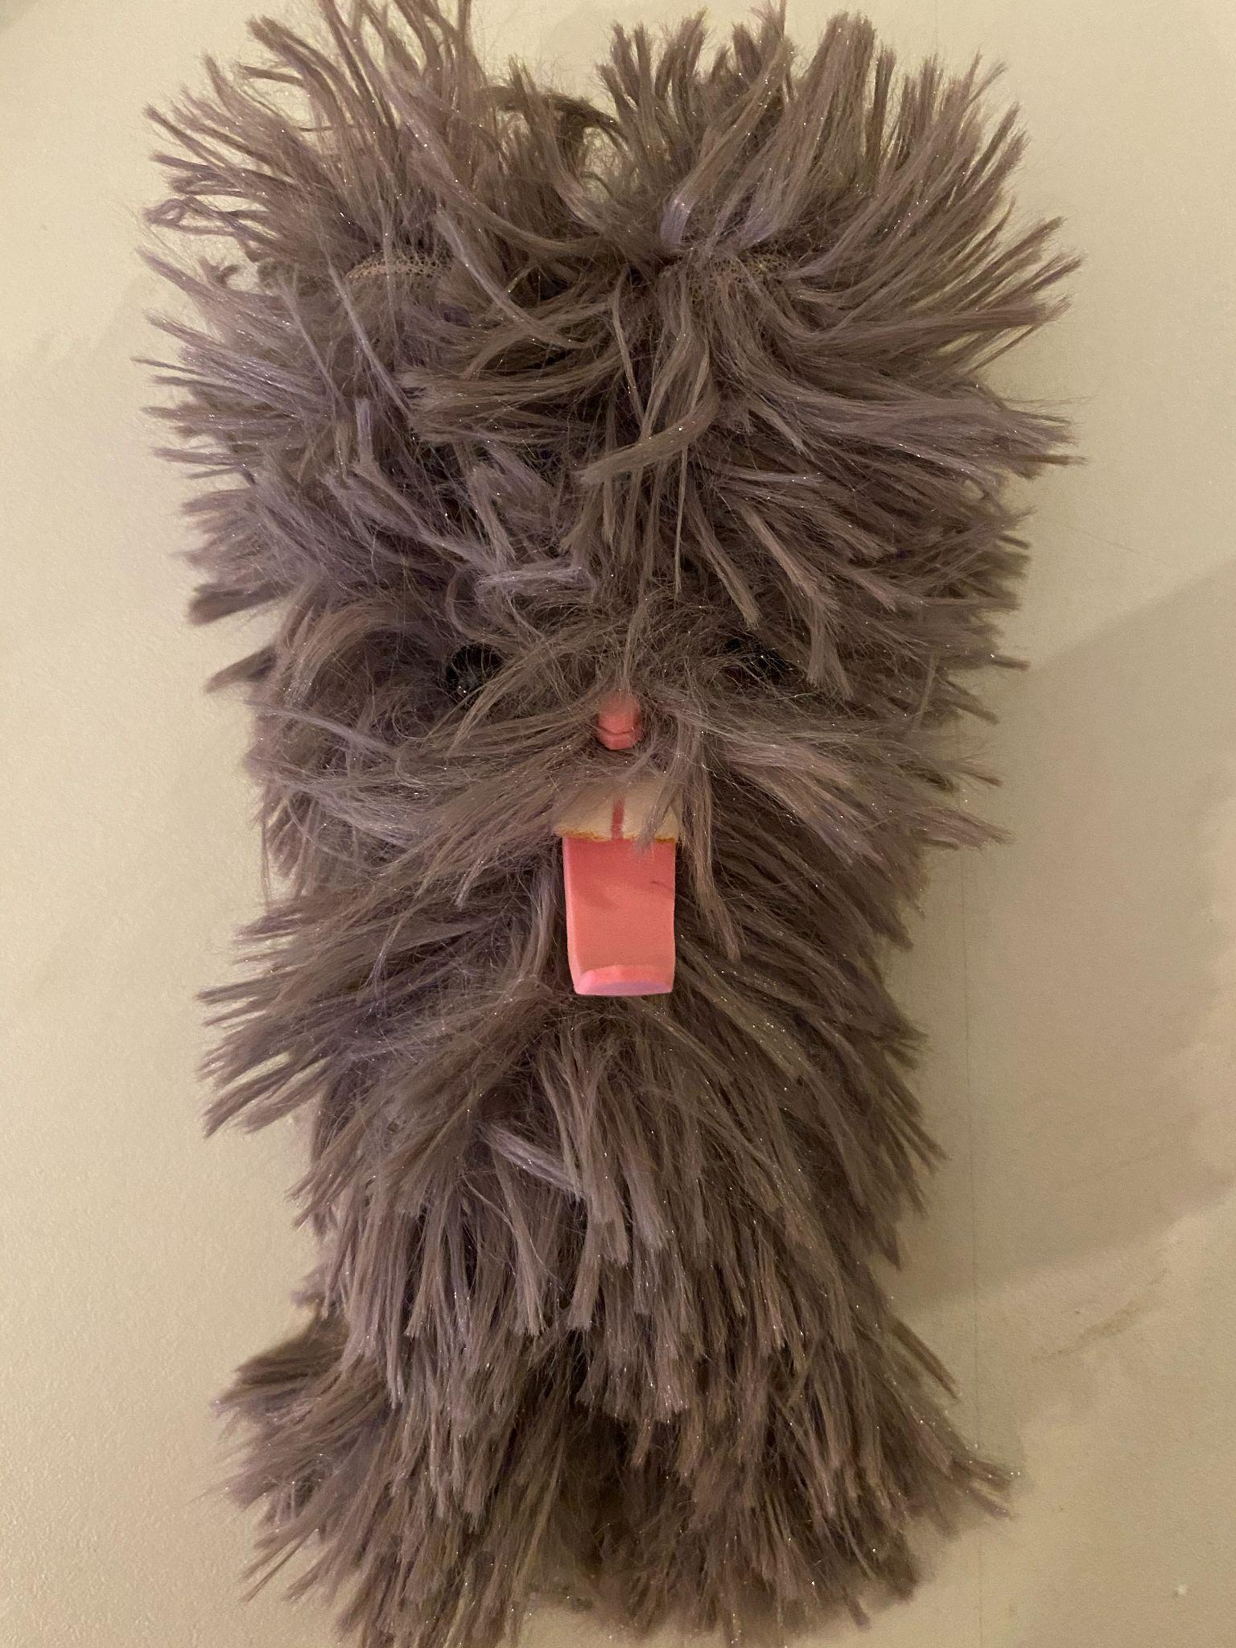
The workprocess
Notes:
Our rabbit, „Find“ it was a lot of work, and discussion, how should the Rabbit be, it was a giving co-operation, experience to have a designer to make the ideas come true, and the our girl advisor came to assisst us.

Slide 12
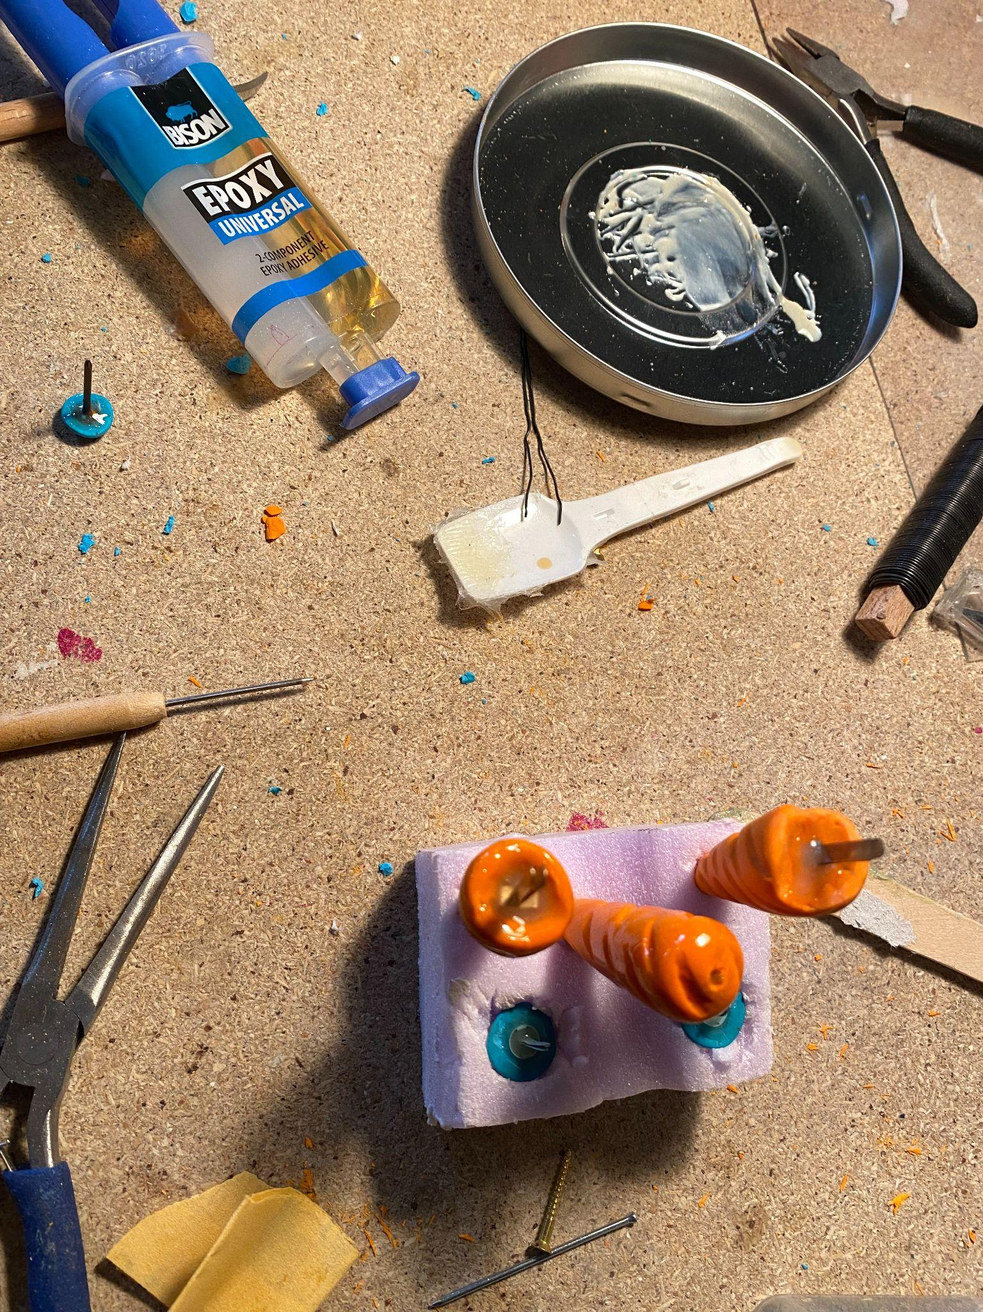
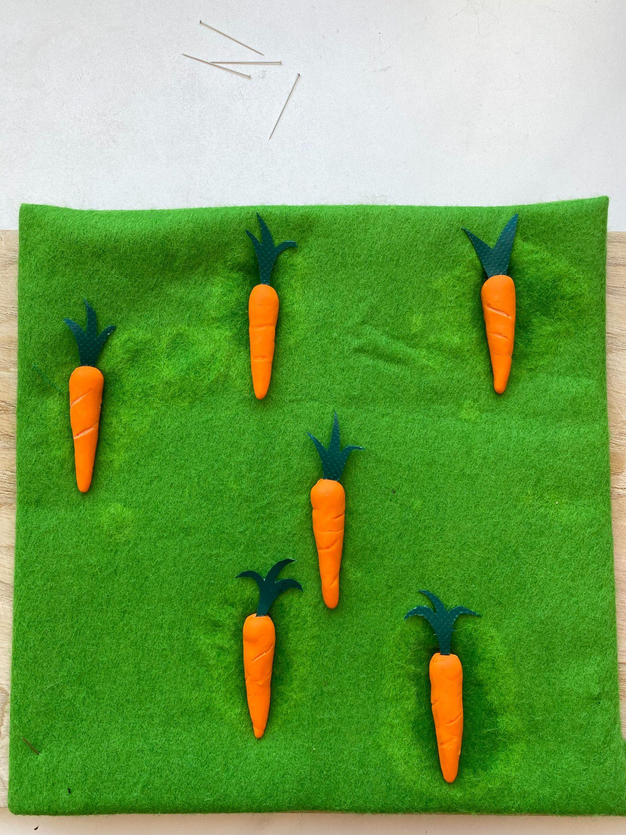
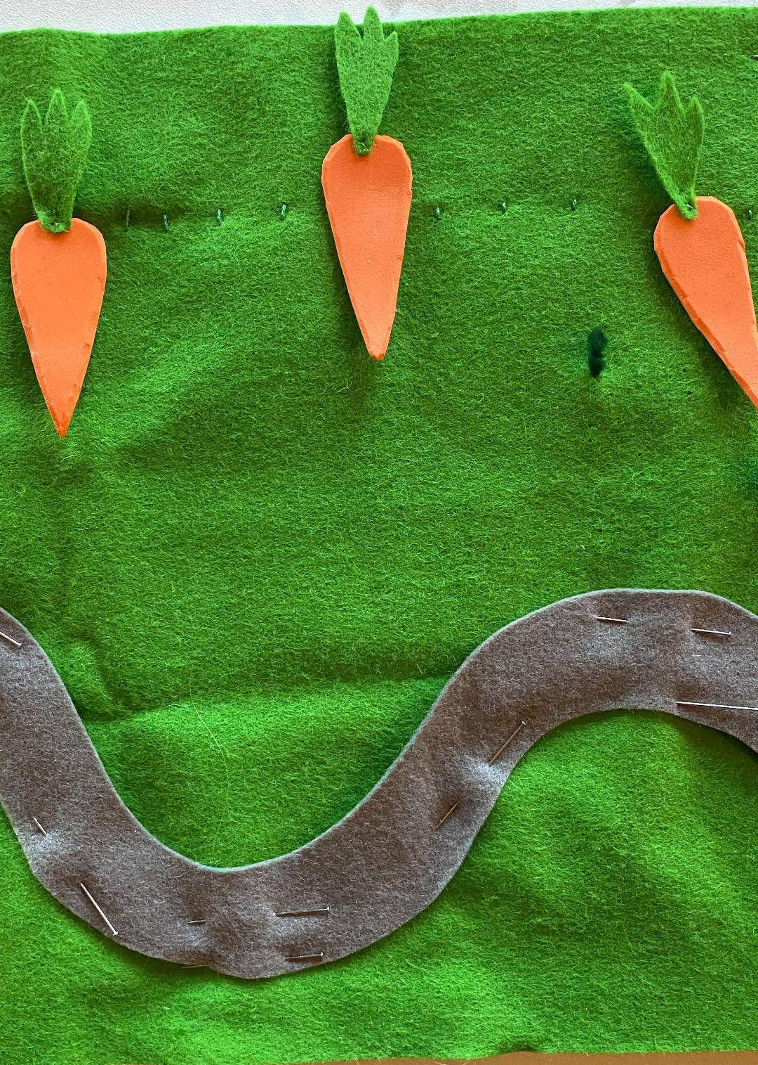
The workprocess
Notes:
How should we have the carrots?
You will see the final outcome in the books here in front of us. It was so much fun and a learning experience for us all. Key word through out the project is FUN AND JOY.

Slide 13
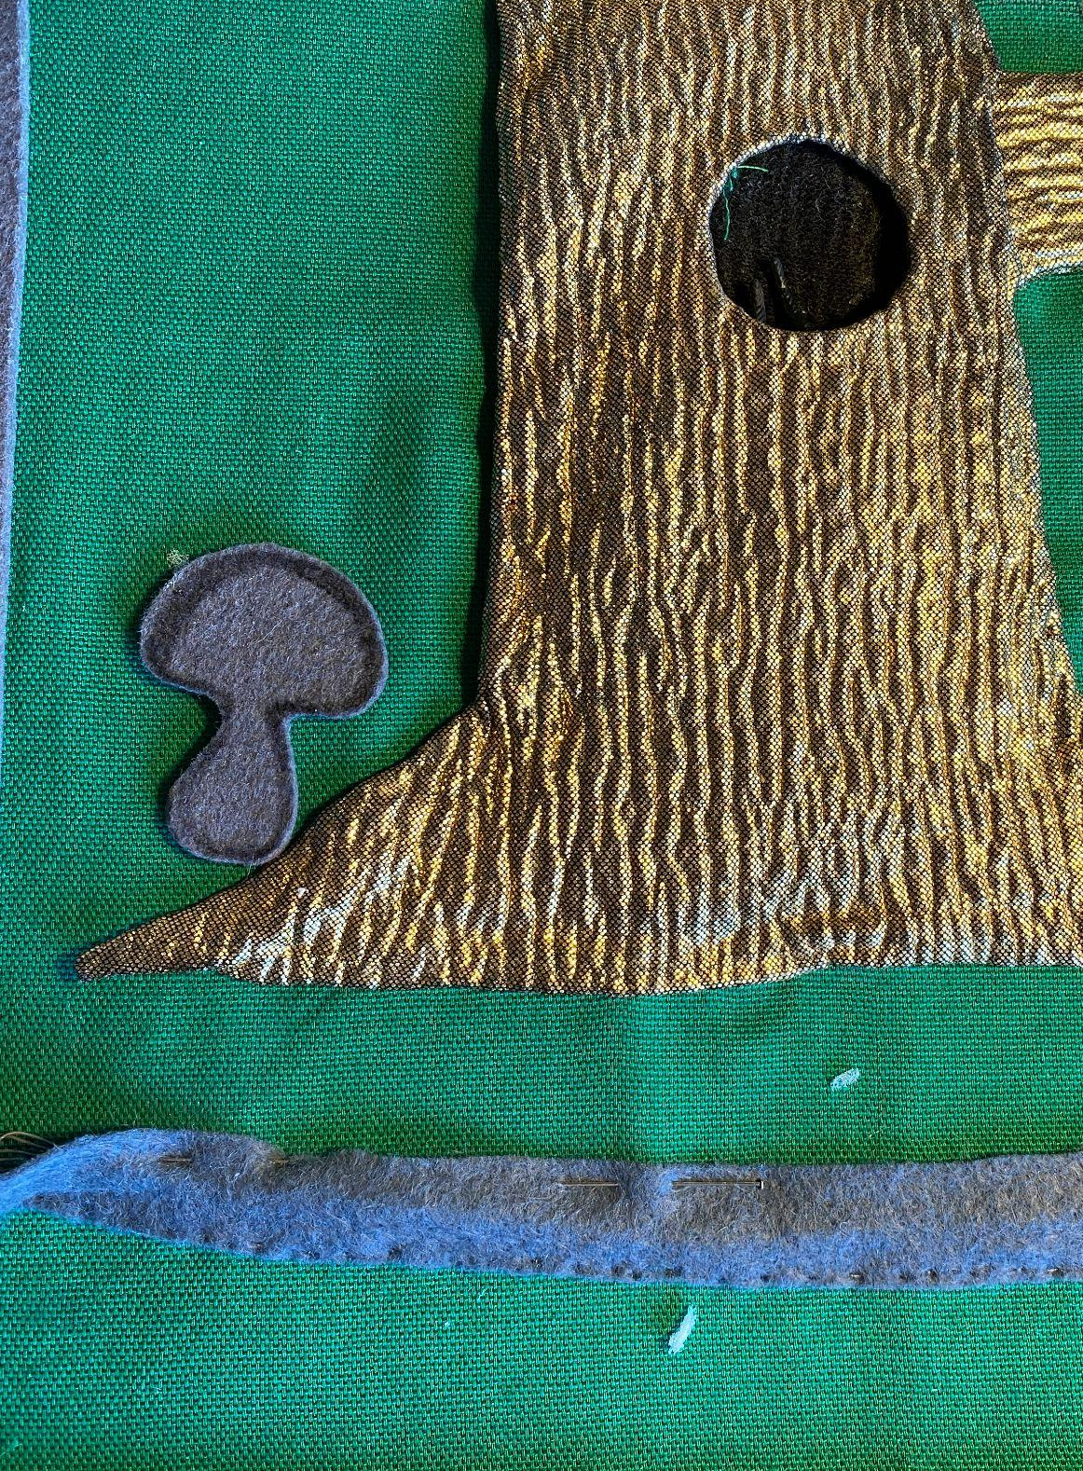
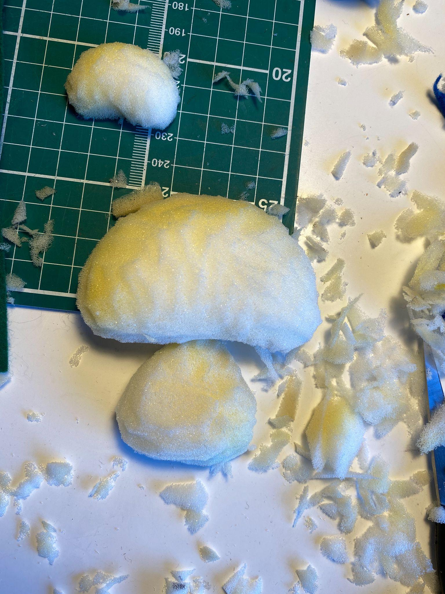
The workprocess
Notes:
Working with different materials, we nees the mushroom soft, but not too soft, what to use?

Slide 14
Our unique advisors
Part of our project was to work with blind teenagers and adults as advisor.
The purpose was to get their perspective and thoughts on the texture, story and general feeling about the books while they were in the making.
For exemple, what is a rabbit, how is a cat, a fence, a bridge etc. What fabric and texture is best to use in the book for those things?
Their help and experience was essential for us to understand what is important for them while enjoying a good book.
„I know a book is a good book when I know everything happening while I‘m reading it“
Notes:
One adult blind person said: to read the book, I dont need vision. The „knew“ everything that happened. That was our goal and we believe we succeded. In the past many tactile books have been „very visual“ and we wanted away from that.

Slide 15
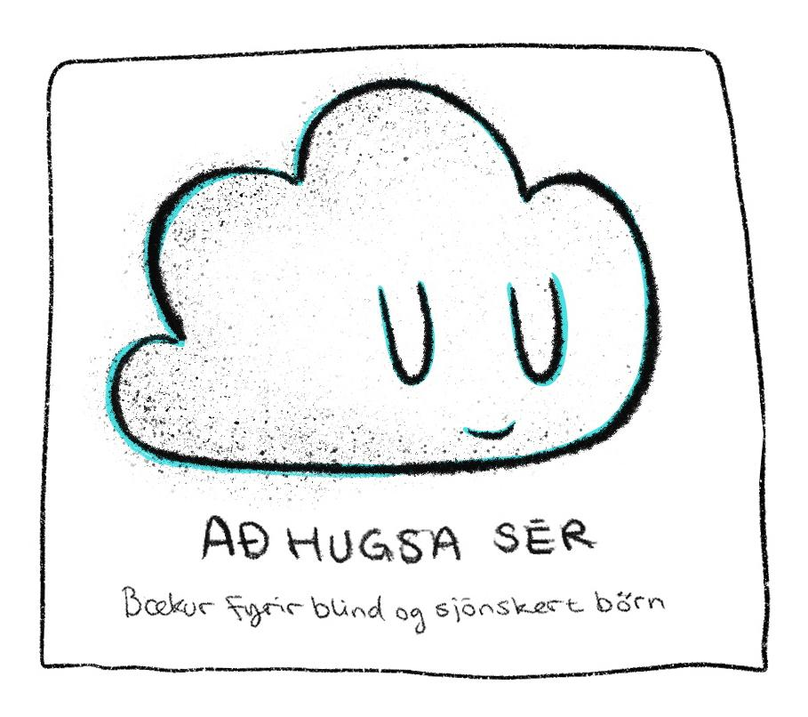
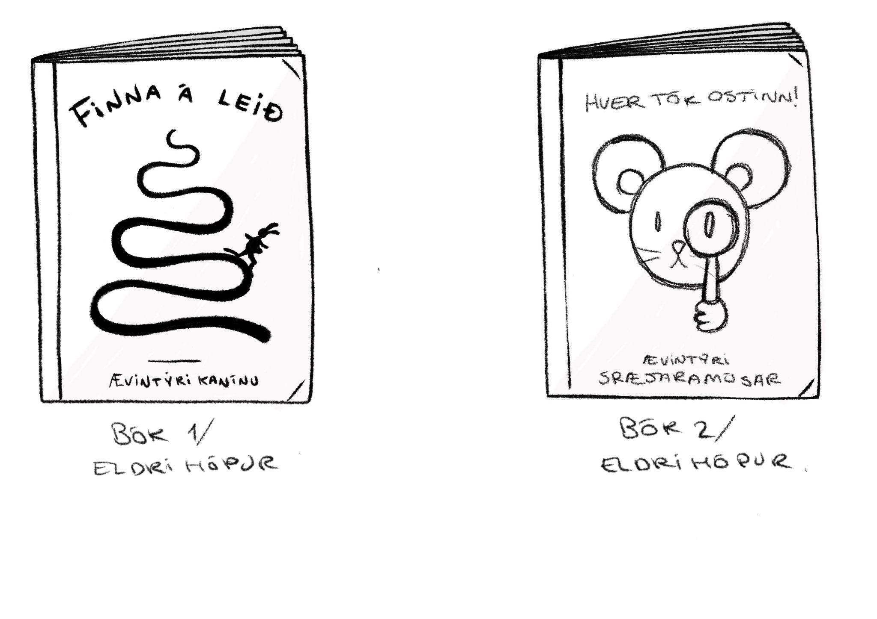
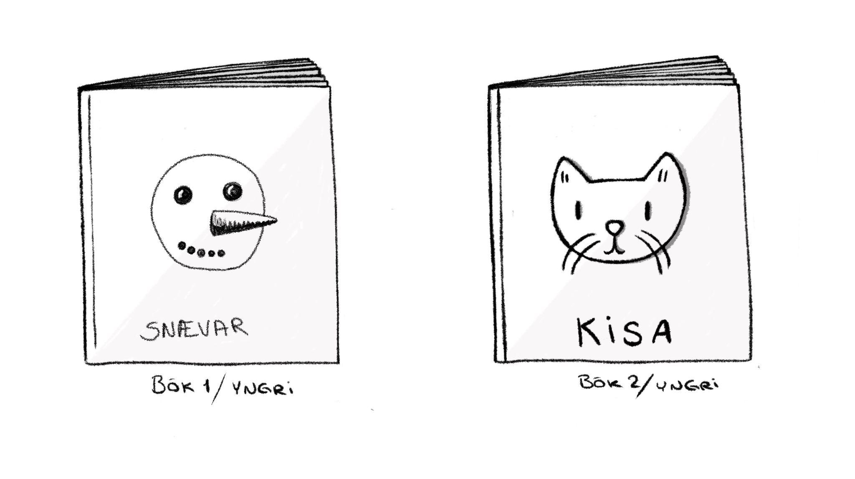
4 ideas
Four ideas became stories for our books
Two for the older group, one about a rabbit that wanted to walk alone home from school and another one about a mouse that lost her cheese with emphasis on prepositions (under, over, on top of, behind, left right etc.).
Two for the younger children, one about a cat and the other one about a snowman.
All the books are both in Braille and with printed letters. Braille is for pretend reading.

Slide 16
Braille and printed letters

Slide 17
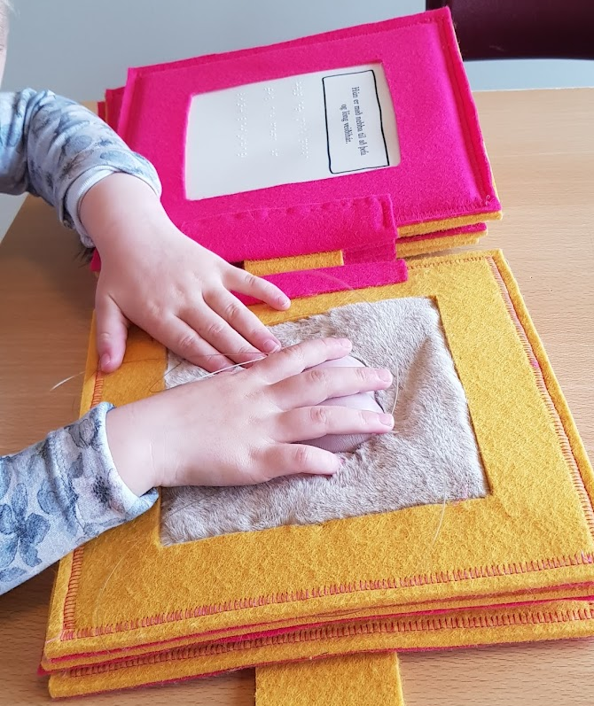
Testing our tactile books
When the books were almost ready we visited a 4 year old girl in kindergarden, who is one of our children. It was a great success and she loved them.

Slide 18
Readings from our books
Notes:
Our young advisors reading from two of the books, videos at the conference.

Slide 19
With a child in your arms and book in hand
One of our famous Icelandic children‘s books author said a few years ago:
„Reading a book with a child gives them an opportunity to ask questions and for the parents to get a glimpse of how the child mind works. A children‘s book creates a peaceful moment to talk about our thought and have a mindful moment. It gives protection, comfort, hugs and teaching moments. Lets take care of each other with children in our arms and a book in hand“.
These words summarize the importance of our Project „Just Imagine“‘

Slide 20
Notes:
The main team in the Project, Rannveig, Ninna and Ásta ☺

Slide 21
Final words for the future
With this projet we have adressed the importance of meeting every childrens needs and we hope from the bottom of our hearts that these books will encourage other designers, writers and publishing companies to publish more books that are for all children, because all children love tactile books.

Slide 22
Thank you
Notes:
Our four books that you now have time to look at and read in icelandic ☺

