Slide 1
Removing Barriers in Education With Inclusion Tools and Technology
Lars Ballieu Christensen
Advisor, Ph.D., M.Sc.
Tanja Stevns
Educator, Vision Impairment

Slide 2
Sensus
Founded 1987 in Denmark
Highly specialised
Inclusion technology
SensusAccess, SensusLibrary, SensusBraille
SensusComply
International projects
Accessibility Consultancy
WCAG Audits of websites, mobile apps
Professional services (procurement, implementation)
Support and training (developers, web authors, …)

Slide 3
Barriers in Education
Universities and other academic institutions all face the same challenges across the world:
Providing accessible materials
Providing alternate formats
Providing both without delay

Slide 4
Sensus’ Mission
To remove barriers
To promote inclusion
To empower students to become independent and self-sufficient
Sensus technology is used by schools in USA, the UK, EU, Australia and Canada

Slide 5
SensusAccess
Self-service alternate media solution
SensusAccess
Produces MP3 audio files
Produces structured audio books
Produces e-books
Produces digital Braille books
Converts inaccessible and tricky documents into more accessible formats
Supports multitude of languages

Slide 6
BeeLine

Slide 7
BeeLine
Created to support speed reading
Reading on small screens
BeeLine for Dyslexia
BeeLine for ADHD/ADD
BeeLine for CVI
Few studies but results are promising:
Speed, accuracy and fun!

Slide 8
Why SensusAccess?
Independence and self-sufficiency
Inclusion in education and vocation
Availability
Privacy
Multiple formats
Cost and platforms
Accessibility support in online education
Long-term, inclusive, open

Slide 9
SensusAccess Users
Users with disabilities
Blind, partially sighted, reading impaired, learning disorders, …
At-risk students
Mainstream students, faculty
Poor language skills, different learning styles, foreign language skills, …
Material production
Alternate media professionals, student workers, faculty, professionals, administrators, …

Slide 10
SensusAccess at a glance
Email
Web
LTI
API
Training services
Reporting services
Well-known technologies
Audio, Braille, DAISY, e-books, OCR, translation, clean-up, BeeLine Reader, remediation, AI/ML, office automation, …
Automated Workflows
MP3, EBOOK, DAISY, BRAILLE, Remediation, BeeLining, Translation
Document formats
.dOc, .docx, .ppt, .pptx, .htm, .html, .xml, .txt, .asc, .rtf, .pdf (all types), .epub, .mobi, .TEX, .tif, .gif, .bmp, .jpeg, .jpg, .j2k, .jp2, .jpx, .pcx, .dcx, .PNG, .djv
Languages
All major and many smaller European languages, US English, LA Spanish, Arabic, Russian, several Asian languages and more

Slide 11
Positioning
 |  | Document complexity
 |  | Simple | Complex
Timeframe | No urgency | SensusAccess | Not SensusAccess or only as tool
 | Urgent | SensusAccess | SensusAccess Not ideal but better than no conversion

Slide 13
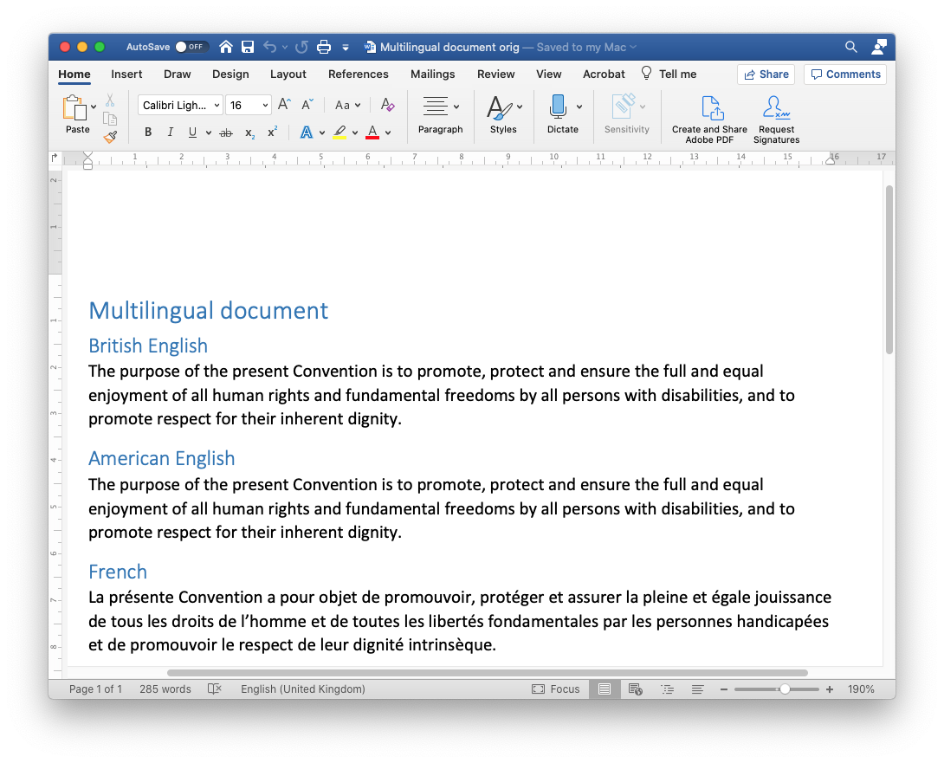
Word to EPUB3 with multi-lingual media overlay

Slide 14
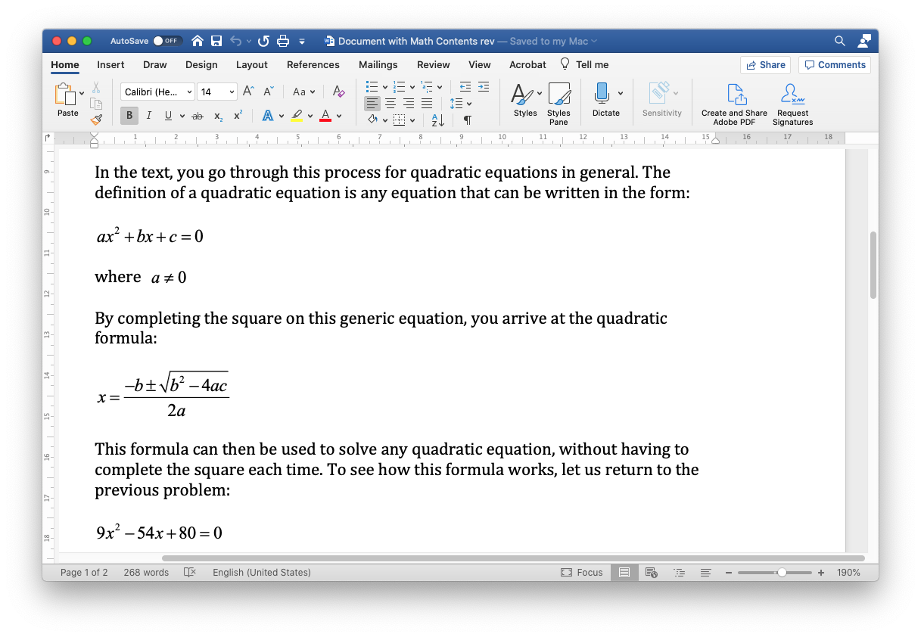
Word to EPUB3 and DAISY with math content

Slide 15
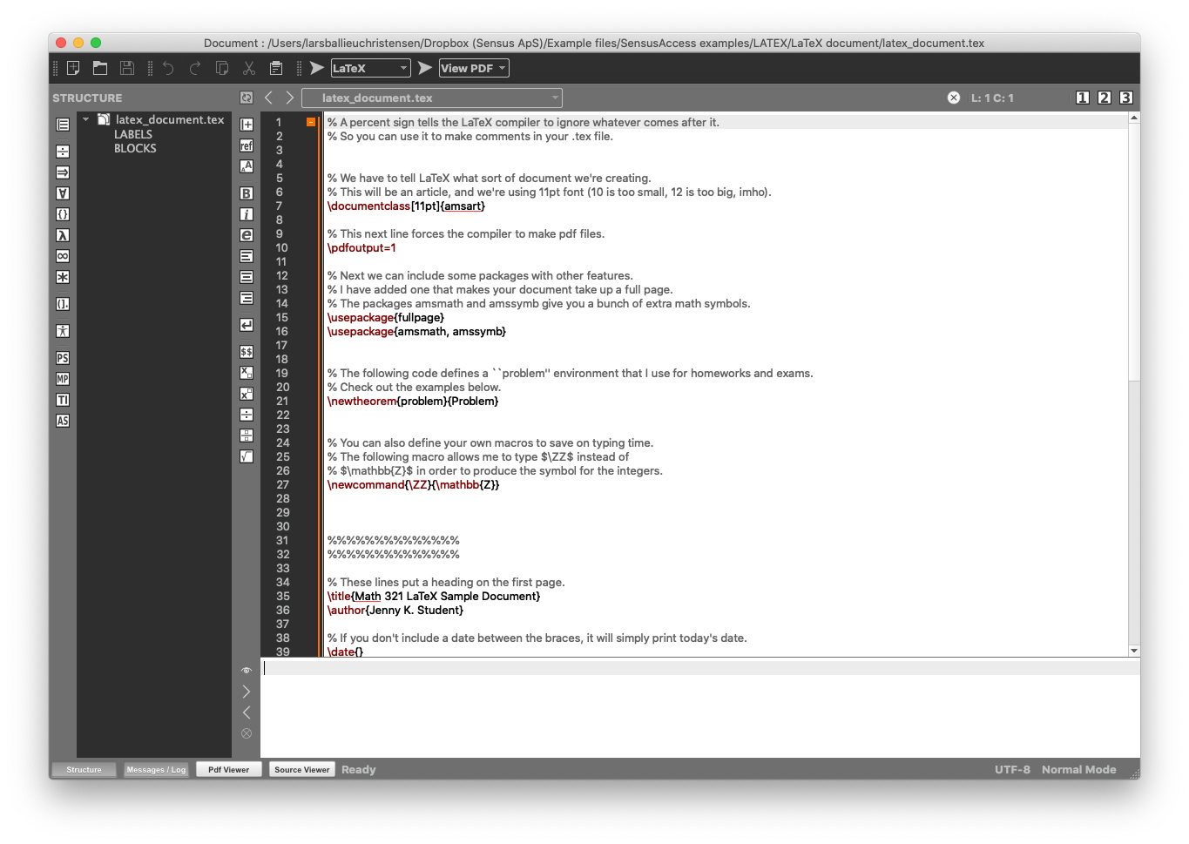
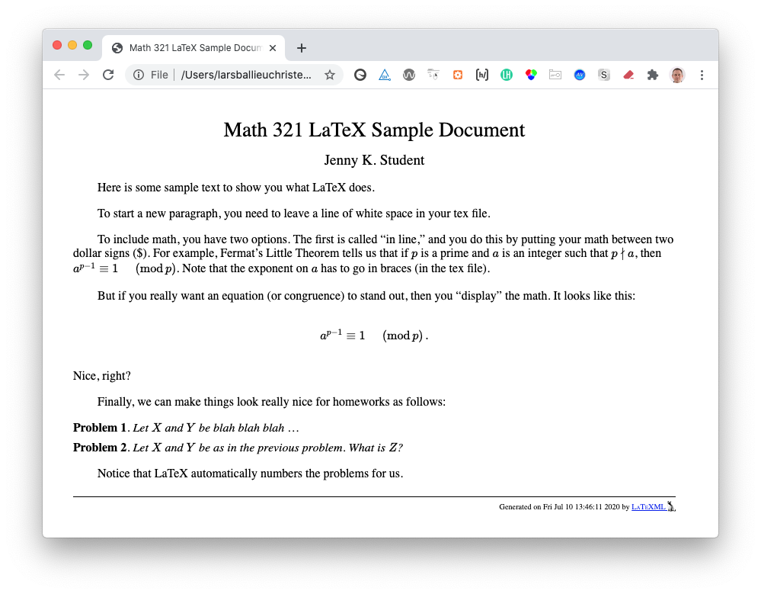
LaTeX to HTML5

Slide 17
SensusAccess e-learning
Introduction to the course
20 mins
Introduction to SensusAccess
Simple conversions
Advanced conversions
Special conversions
Producing MP3 files
Designing and creating accessible documents
Producing Braille
Converting inaccessible and tricky documents
Producing advanced
e-books
Producing simple
e-books
Producing DAISY talking books
20 mins each plus exercises
25 mins each plus exercises
25 mins each plus exercises
https://www.sensusaccess.com/sensusaccess-e-learning

Slide 18
Visit http://scribe.stanford.edu

Slide 20
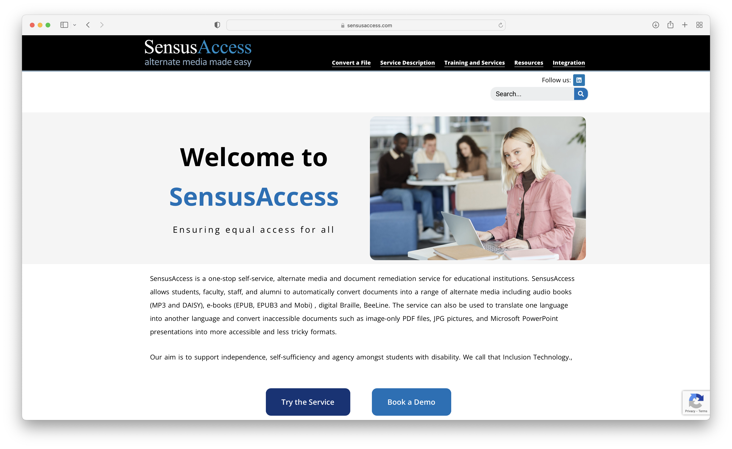
Try at www.SensusAccess.com

Slide 21
Questions; comments
?!

Slide 22
Contact information
Lars Ballieu Christensen
Mail: lars@sensus.dk
Phone: +45 40 32 68 23
Tanja Stevns
Mail: tanja@sensus.dk
Phone: +45 23 24 06 72
www.sensusaccess.com

