Slide 1
Independence - a human right!

Slide 2
About us…
Tomas
Project manager - VägVisaren
Schoolteacher and orienteer
Lennart
Parasport Örebro
30 year of work with sports for disabled
History
This talk – tactile maps and Microsoft Soundscape
Notes:
Project, VägVisaren, for which I am the project manager. The project is in its third year, and I will during this talk share experiences based on this work.
I am a former schoolteacher and an orienteer since birth with the goal to see “Orienteering for people with visual impairment” becoming a sport but most of all to enjoy the satisfaction when helping visual impaired people to take lead in finding and exploring new places on their own or with their friends.
During the years 1978-1997, Arne Yngström worked to make the sport orienteering accessible to the disabled people and disability groups, such as people with reduced mobility, the mentally handicapped and the visually impaired. This is the heritage we want to explore and develop.
Developing a compass – GPS was coming
Although the tactile map is important in the project, the focus during this talk will also be on how visually impaired people can get to new places with the help of sound. A free iOS-based app, Microsoft Soundscape, allow you to set multiple virtual beacons that will lead you to wherever you want to go.

Slide 3
Independence - a human right!
Feel secure about finding places and find your way back home!
We want…to give the opportunity to people with visual impairment to find their way in their own surroundings.
Discover, explore and see things you have never seen before!
We want …to give children, young people and adults with visual impairments the opportunity to practice orienteering, as a sport activity.
Everyone, with the right conditions, can read a map!
We want …to create conditions for pupils in school to receive a passing grade in the orienteering part in the subject Physical Education.

Slide 4
Feel secure about finding places and find your way back home!
We want…to give the opportunity to people with visual impairment to find their way in their own surroundings.

Slide 5
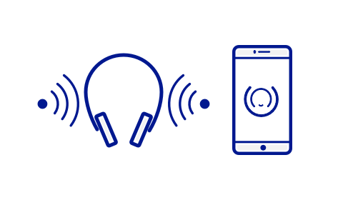
Microsoft Soundscape
soundscape@microsoft.com
“Is a free iOS app that provides travelers who are visually impaired or blind, information about places around them in the environment. Soundscapes will announce names of stores, streets and the direction you are traveling.”

Slide 6
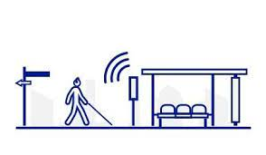
Explore your surroundings!
soundscape@microsoft.com
Support/improve your ”cane training” with the help of sound!
Leave home and get back, safe!
Get to learn new places, with the help of sound!

Slide 8
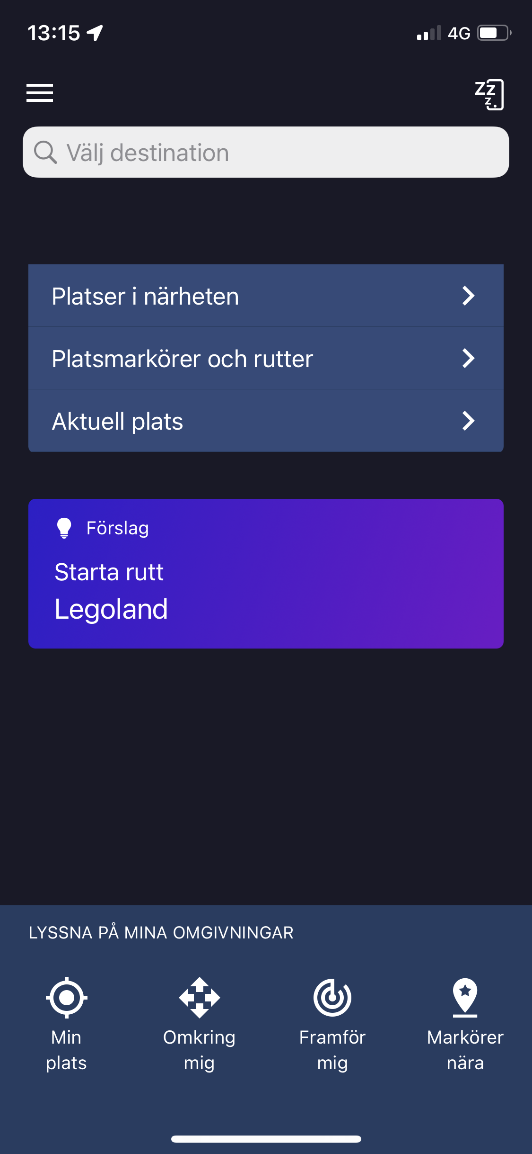
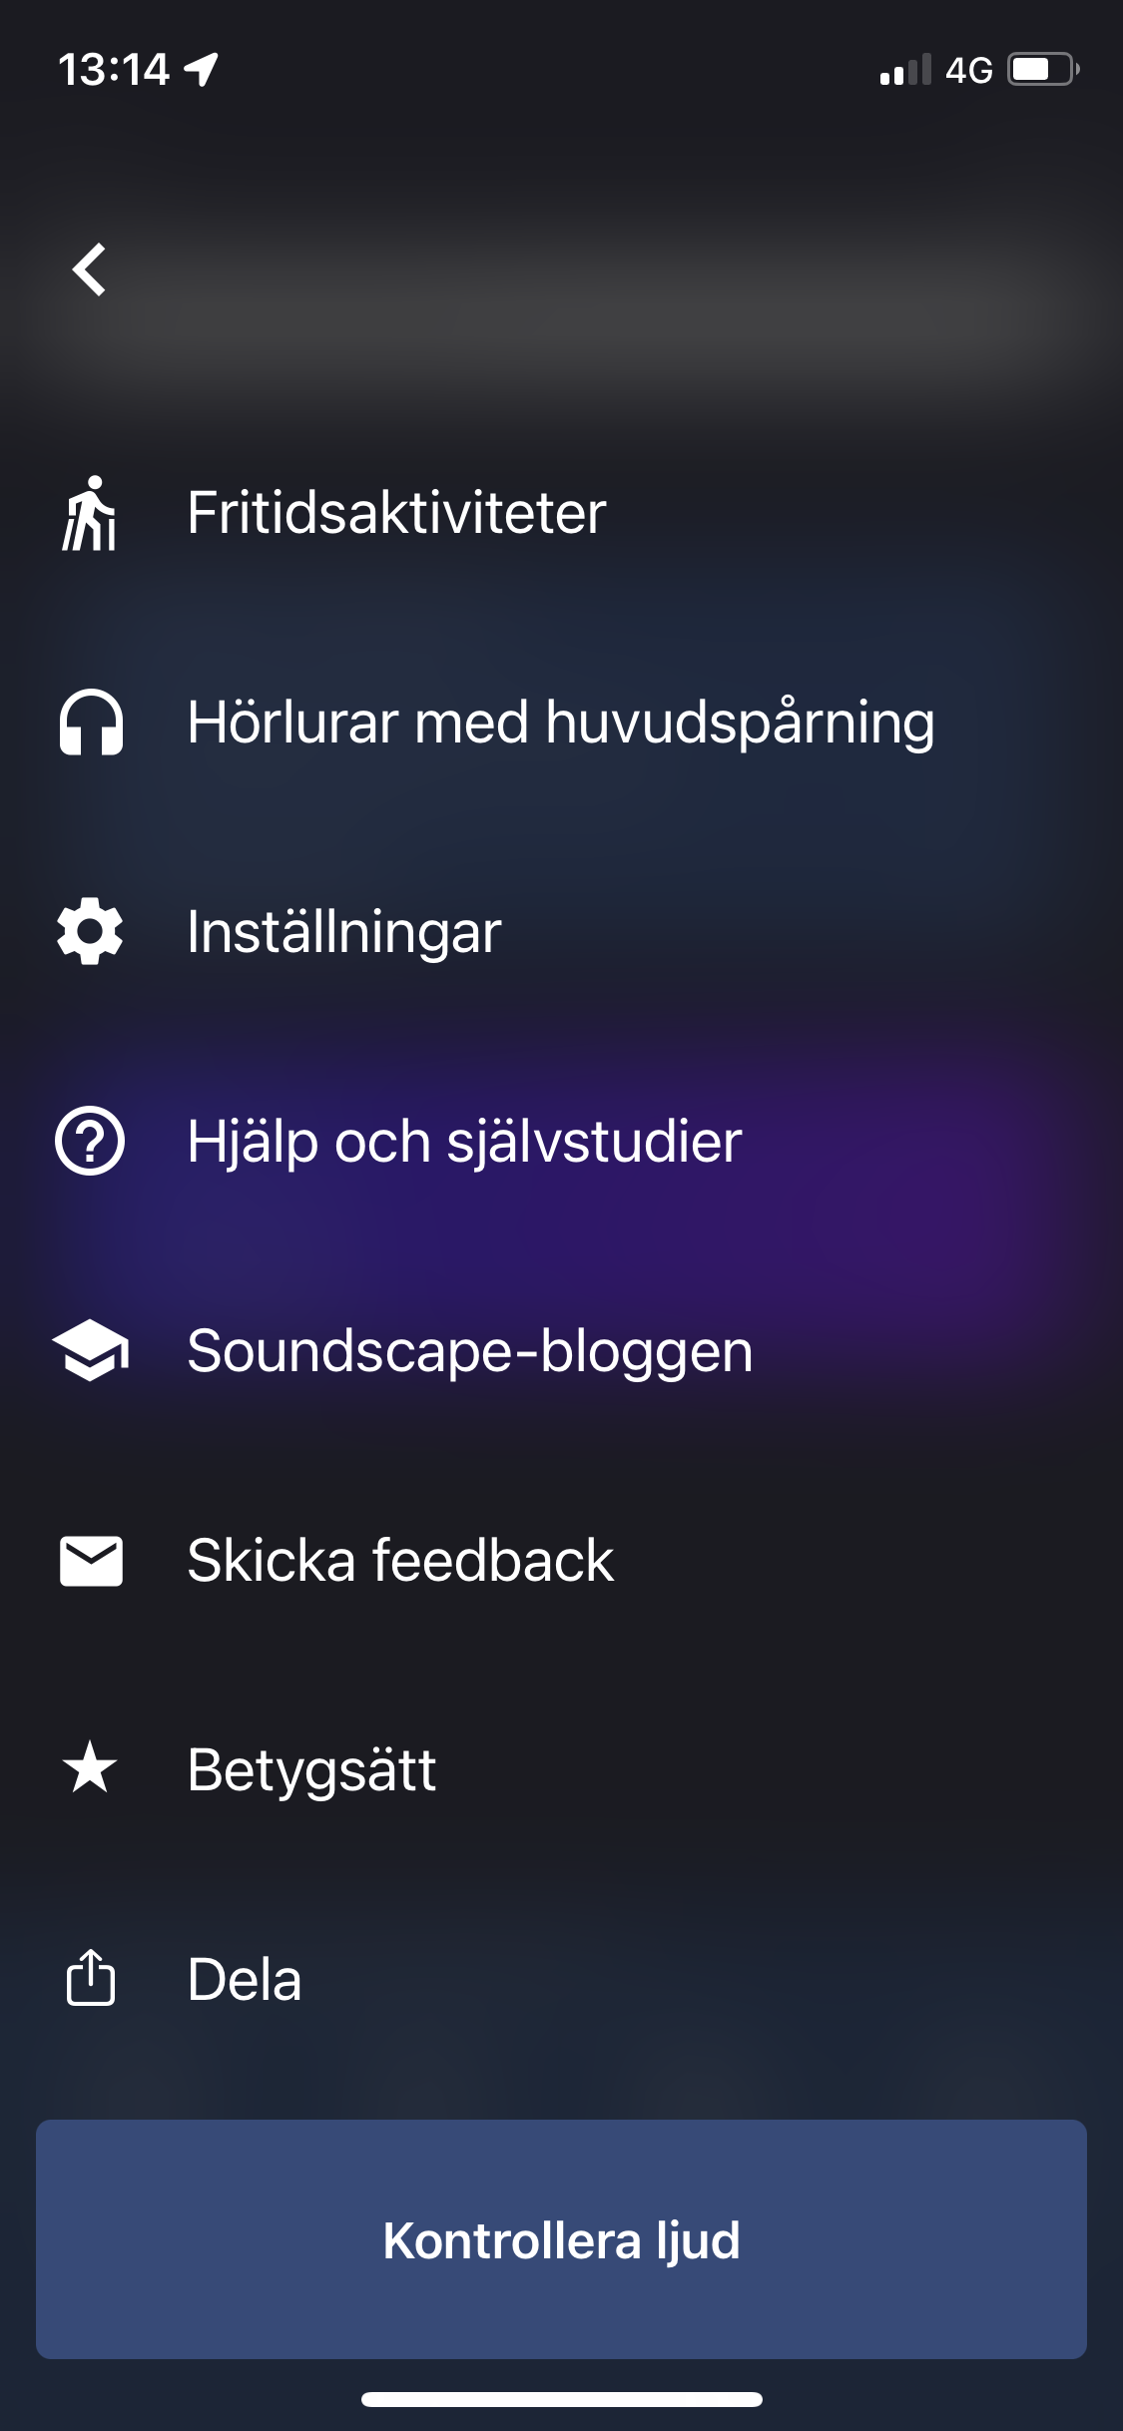
Self studies & FAQ
Settings
A very good way to learn the app is to use ”Help and self study”.
You´ll find it via settings on the front page.

Slide 9
Microsoft Soundscape Author
Computer Beta version
Explanations
Information
”Routes”

Slide 10
Discover, explore and see things you have never seen before!
We want …to give children, young people and adults with visual impairments the opportunity to practice orienteering, as a sport activity.

Slide 11
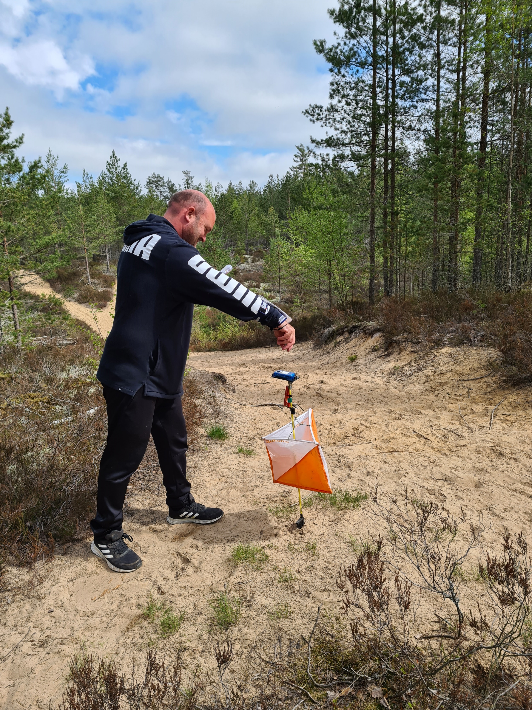
Orienteering for everyone!

Slide 12
Orienteering
Orienteering is a worldwide sport spread in more than 75 countries.
“It´s a sport that require navigational skills using a map to navigate from point to point in diverse and unfamiliar terrain whilst moving at speed. Participants are given a topographical map, usually a specially prepared orienteering map, which they use to find control points.”
Notes:
Orienteering is a worldwide sport spread in more than 75 countries. “It´s a sport that require navigational skills using a map to navigate from point to point in diverse and unfamiliar terrain whilst moving at speed. Participants are given a topographical map, usually a specially prepared orienteering map, which they use to find control points.”
You can do orienteering even if you are disabled, for example in a wheelchair, “Precision-orienteering”.
BUT – you can´t (yet) compete in orienteering if you are visually impaired.

Slide 13
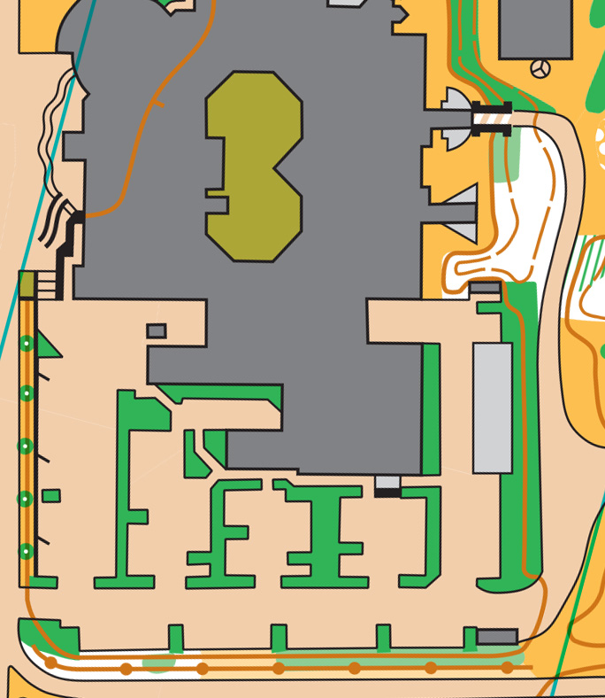
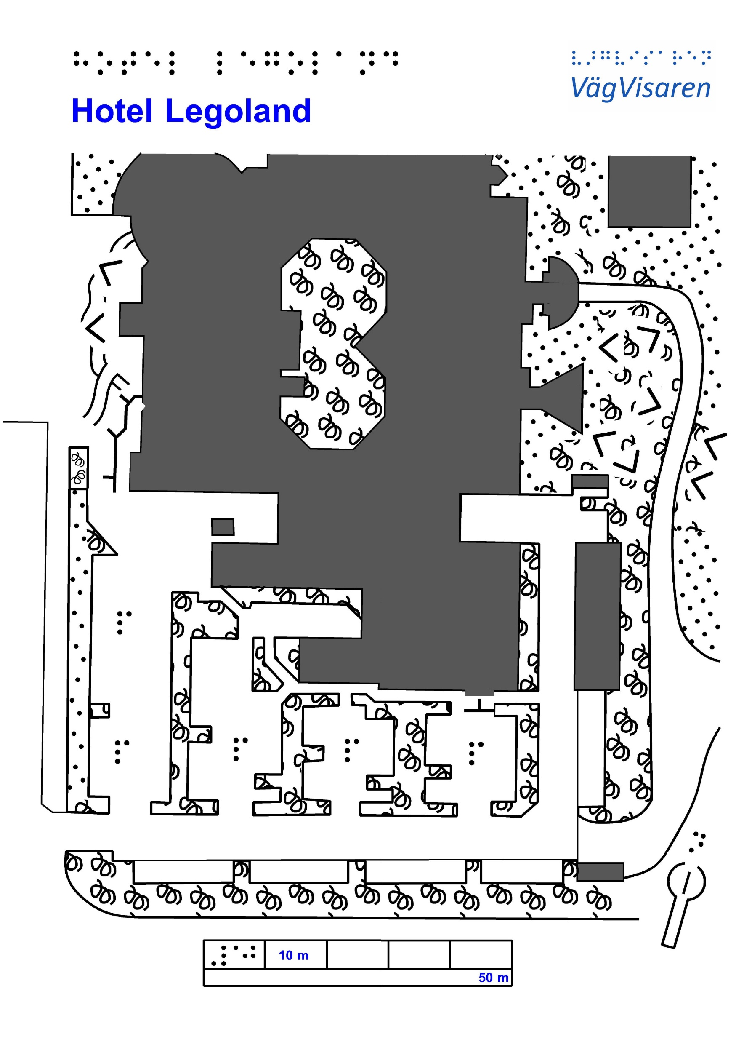
Enlarged regular O-map
Tactile O-map
Notes:
We are going from regular orienteering to orienteering for people with visually impairment or even blindness!

Slide 14
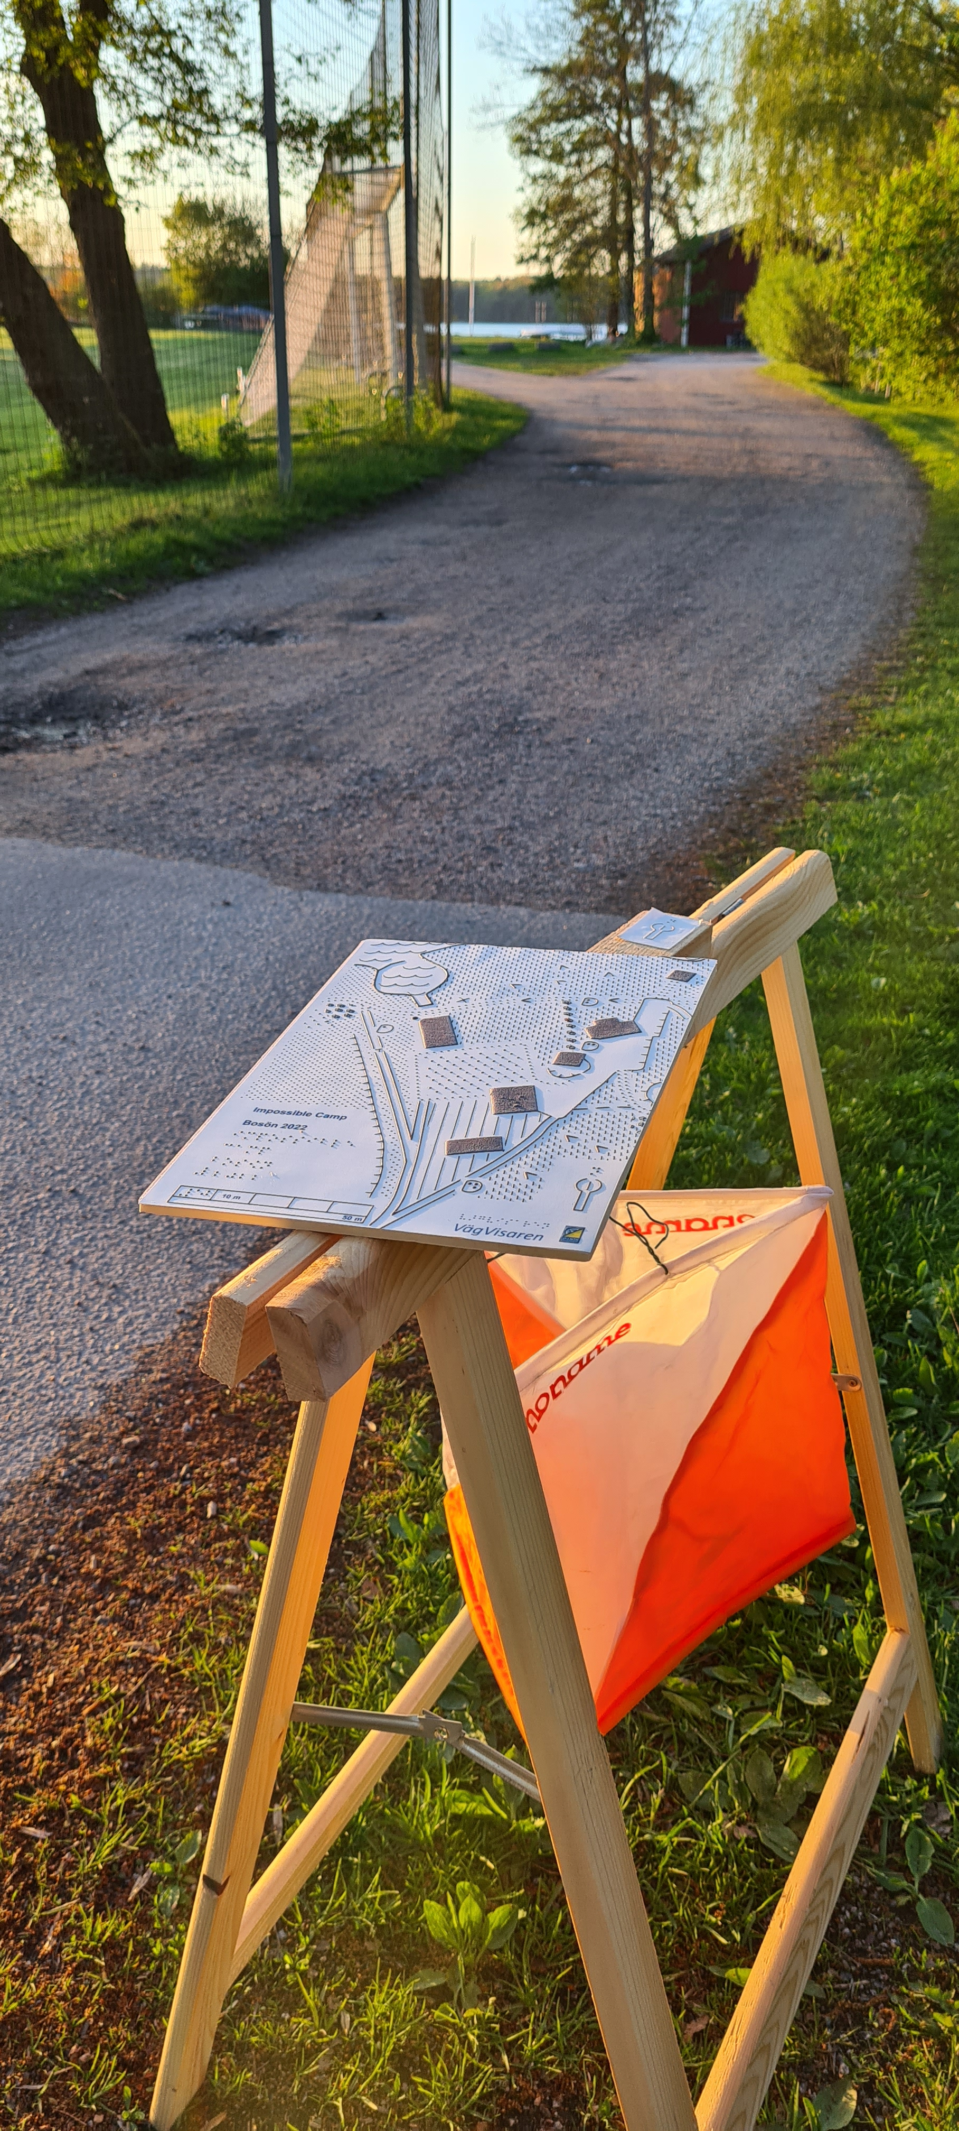
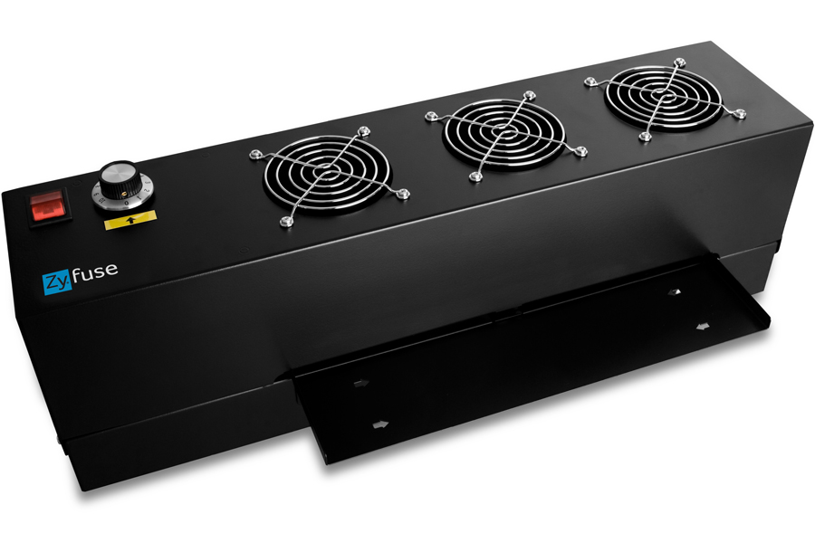
Tactile maps – how are they made?
Black and white
Map symbols
Map raster
Scale
Distance measure
North arrow
Compass…
Control flag with north arrow on top
Zyfuse heating machine
Notes:
Work in progress…dialogue with the target group
Swell paper - two layers – lower layer -> normal paper / upper layer -> millions of microscopic plastic bubbles.
Run a blank piece of paper through the heating machine – nothing will happen. But draw a pencil line or picture in black it will rise when running it through the heating machine!
The microscopic plastic bubbles will expand and become larger
Black and white…(colours for the ones with some visibility!)
Map symbols
Map raster
Scale
Distance measure
North arrow
Compass…

Slide 15
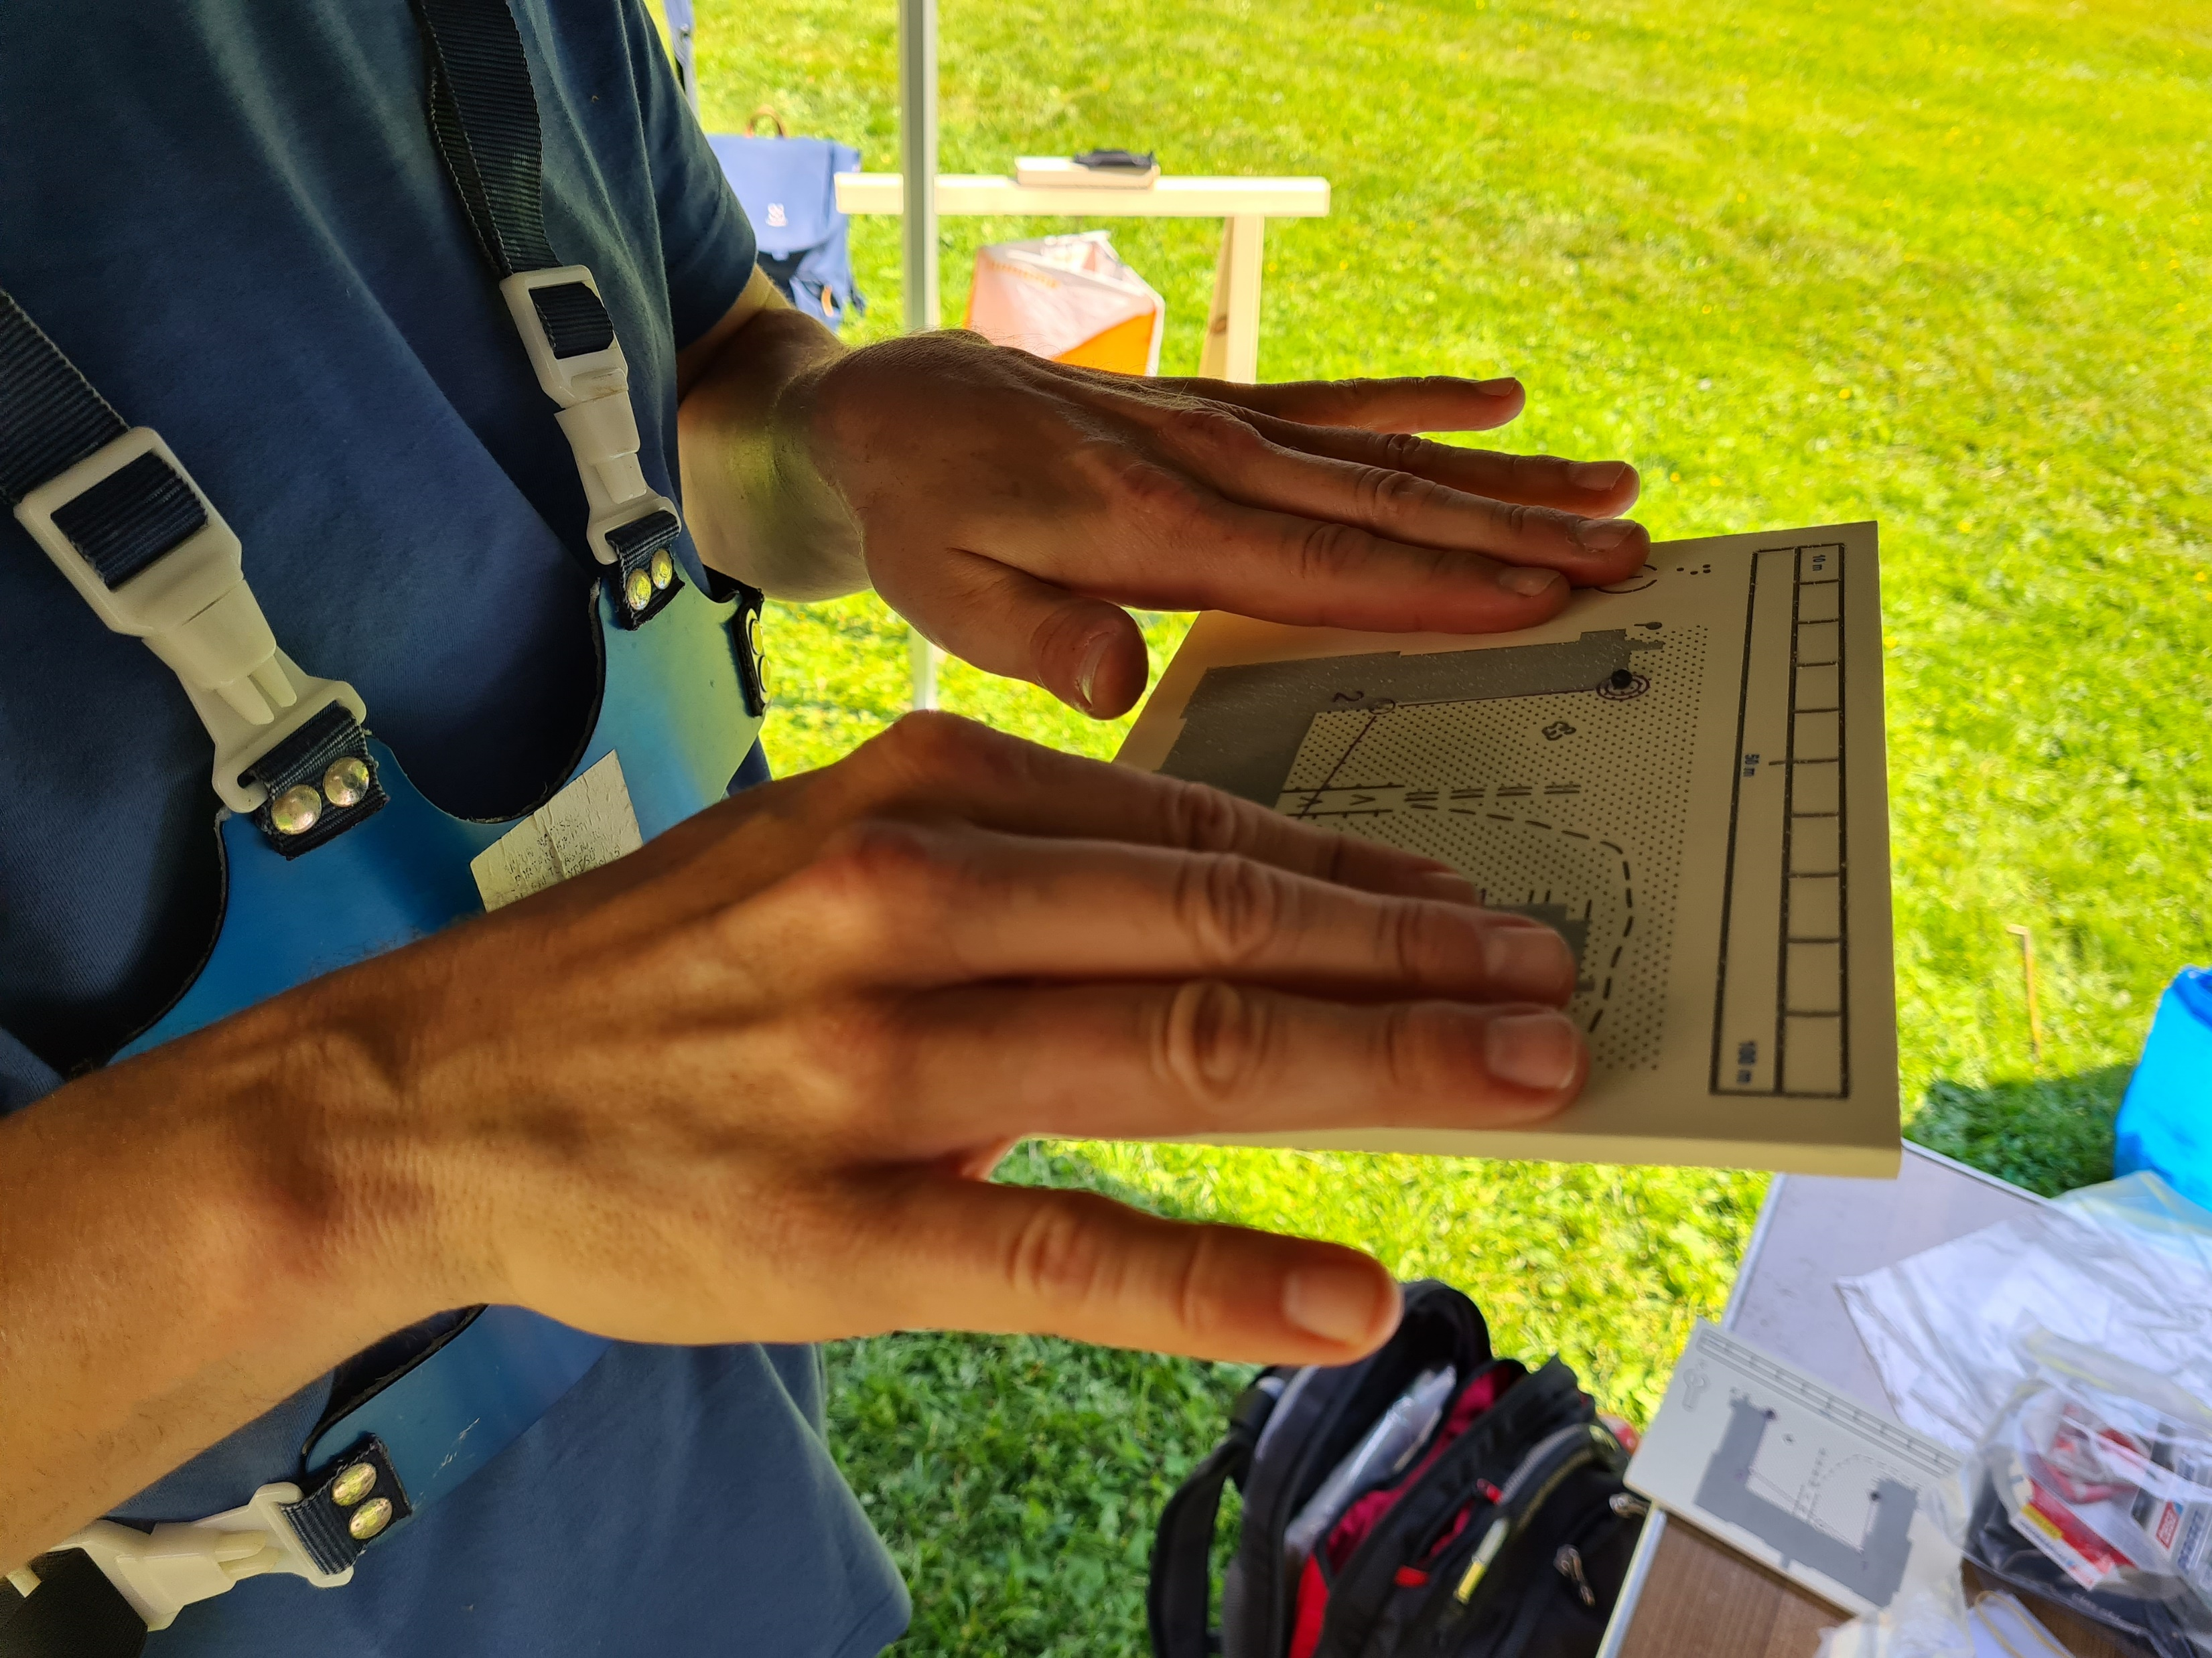
Hold the map
Two hands – white cane in one…
Trying out – what do you like…
Work in progress
Notes:
Map holder for Ski-orienteering
Map holder with magnet

Slide 16
Everyone, with the right conditions, can read a map!
We want …to create conditions for pupils in school to receive a passing grade in the orienteering part in the subject Physical Education.

Slide 17
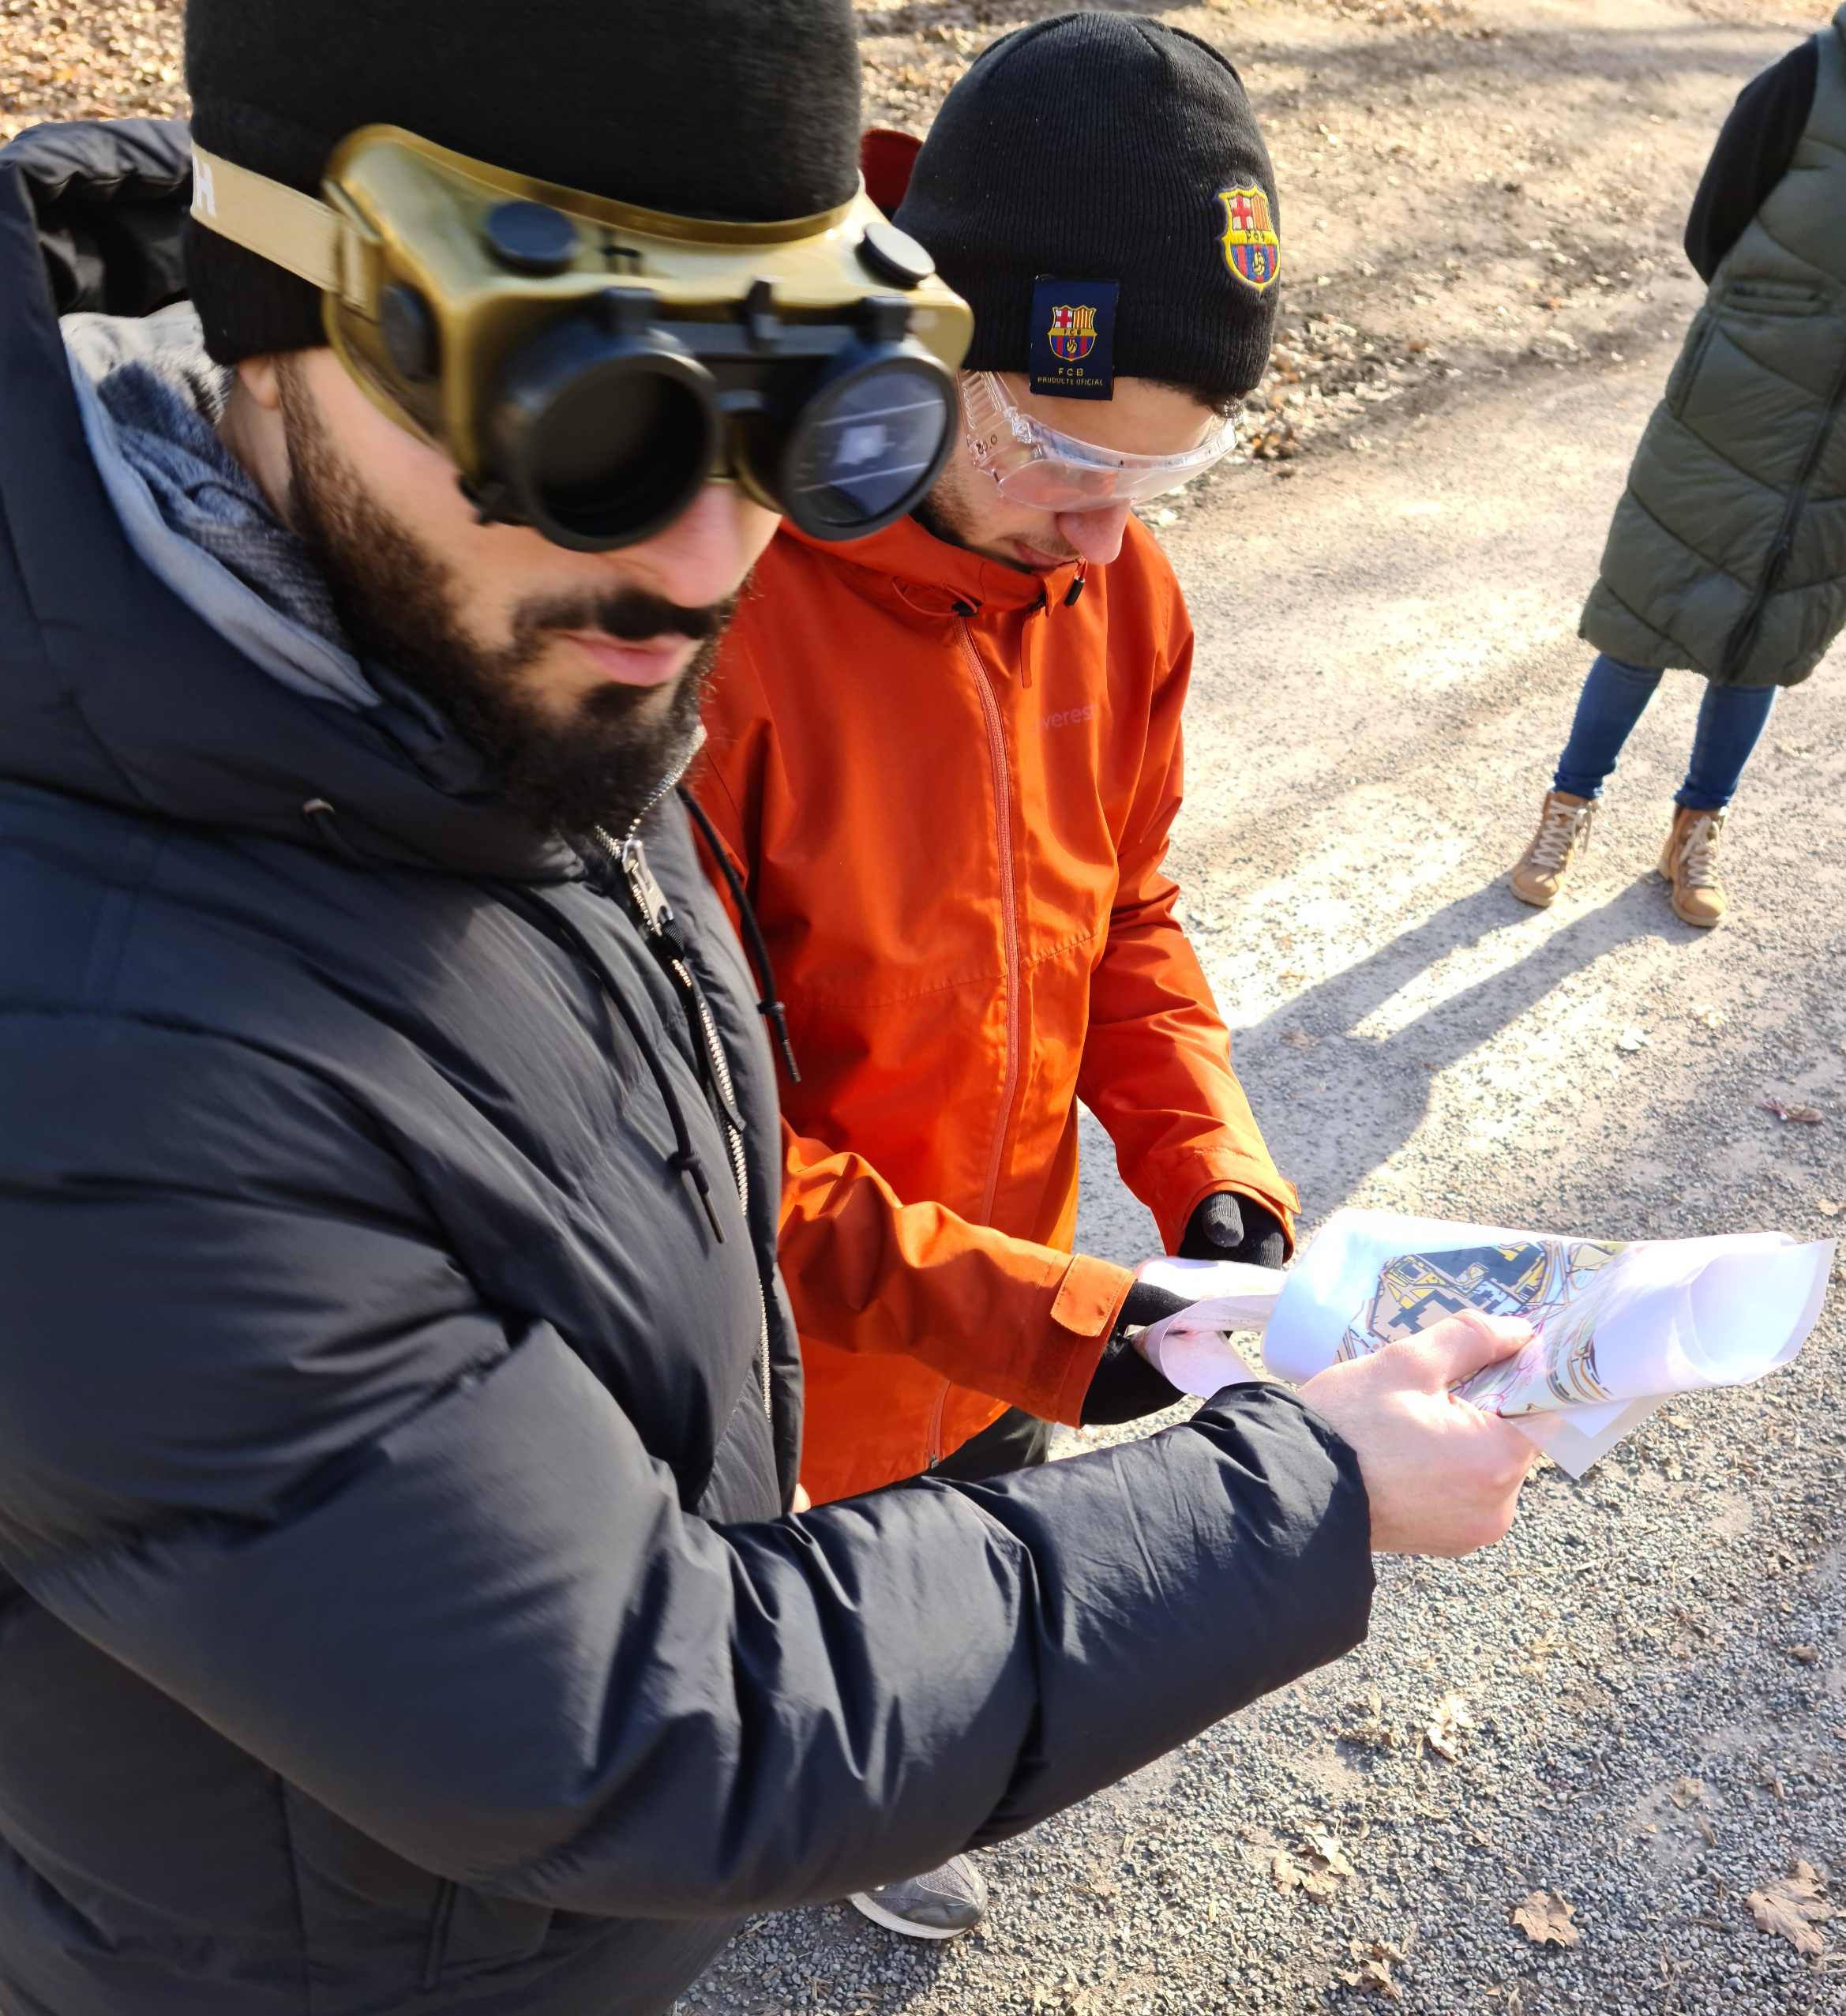
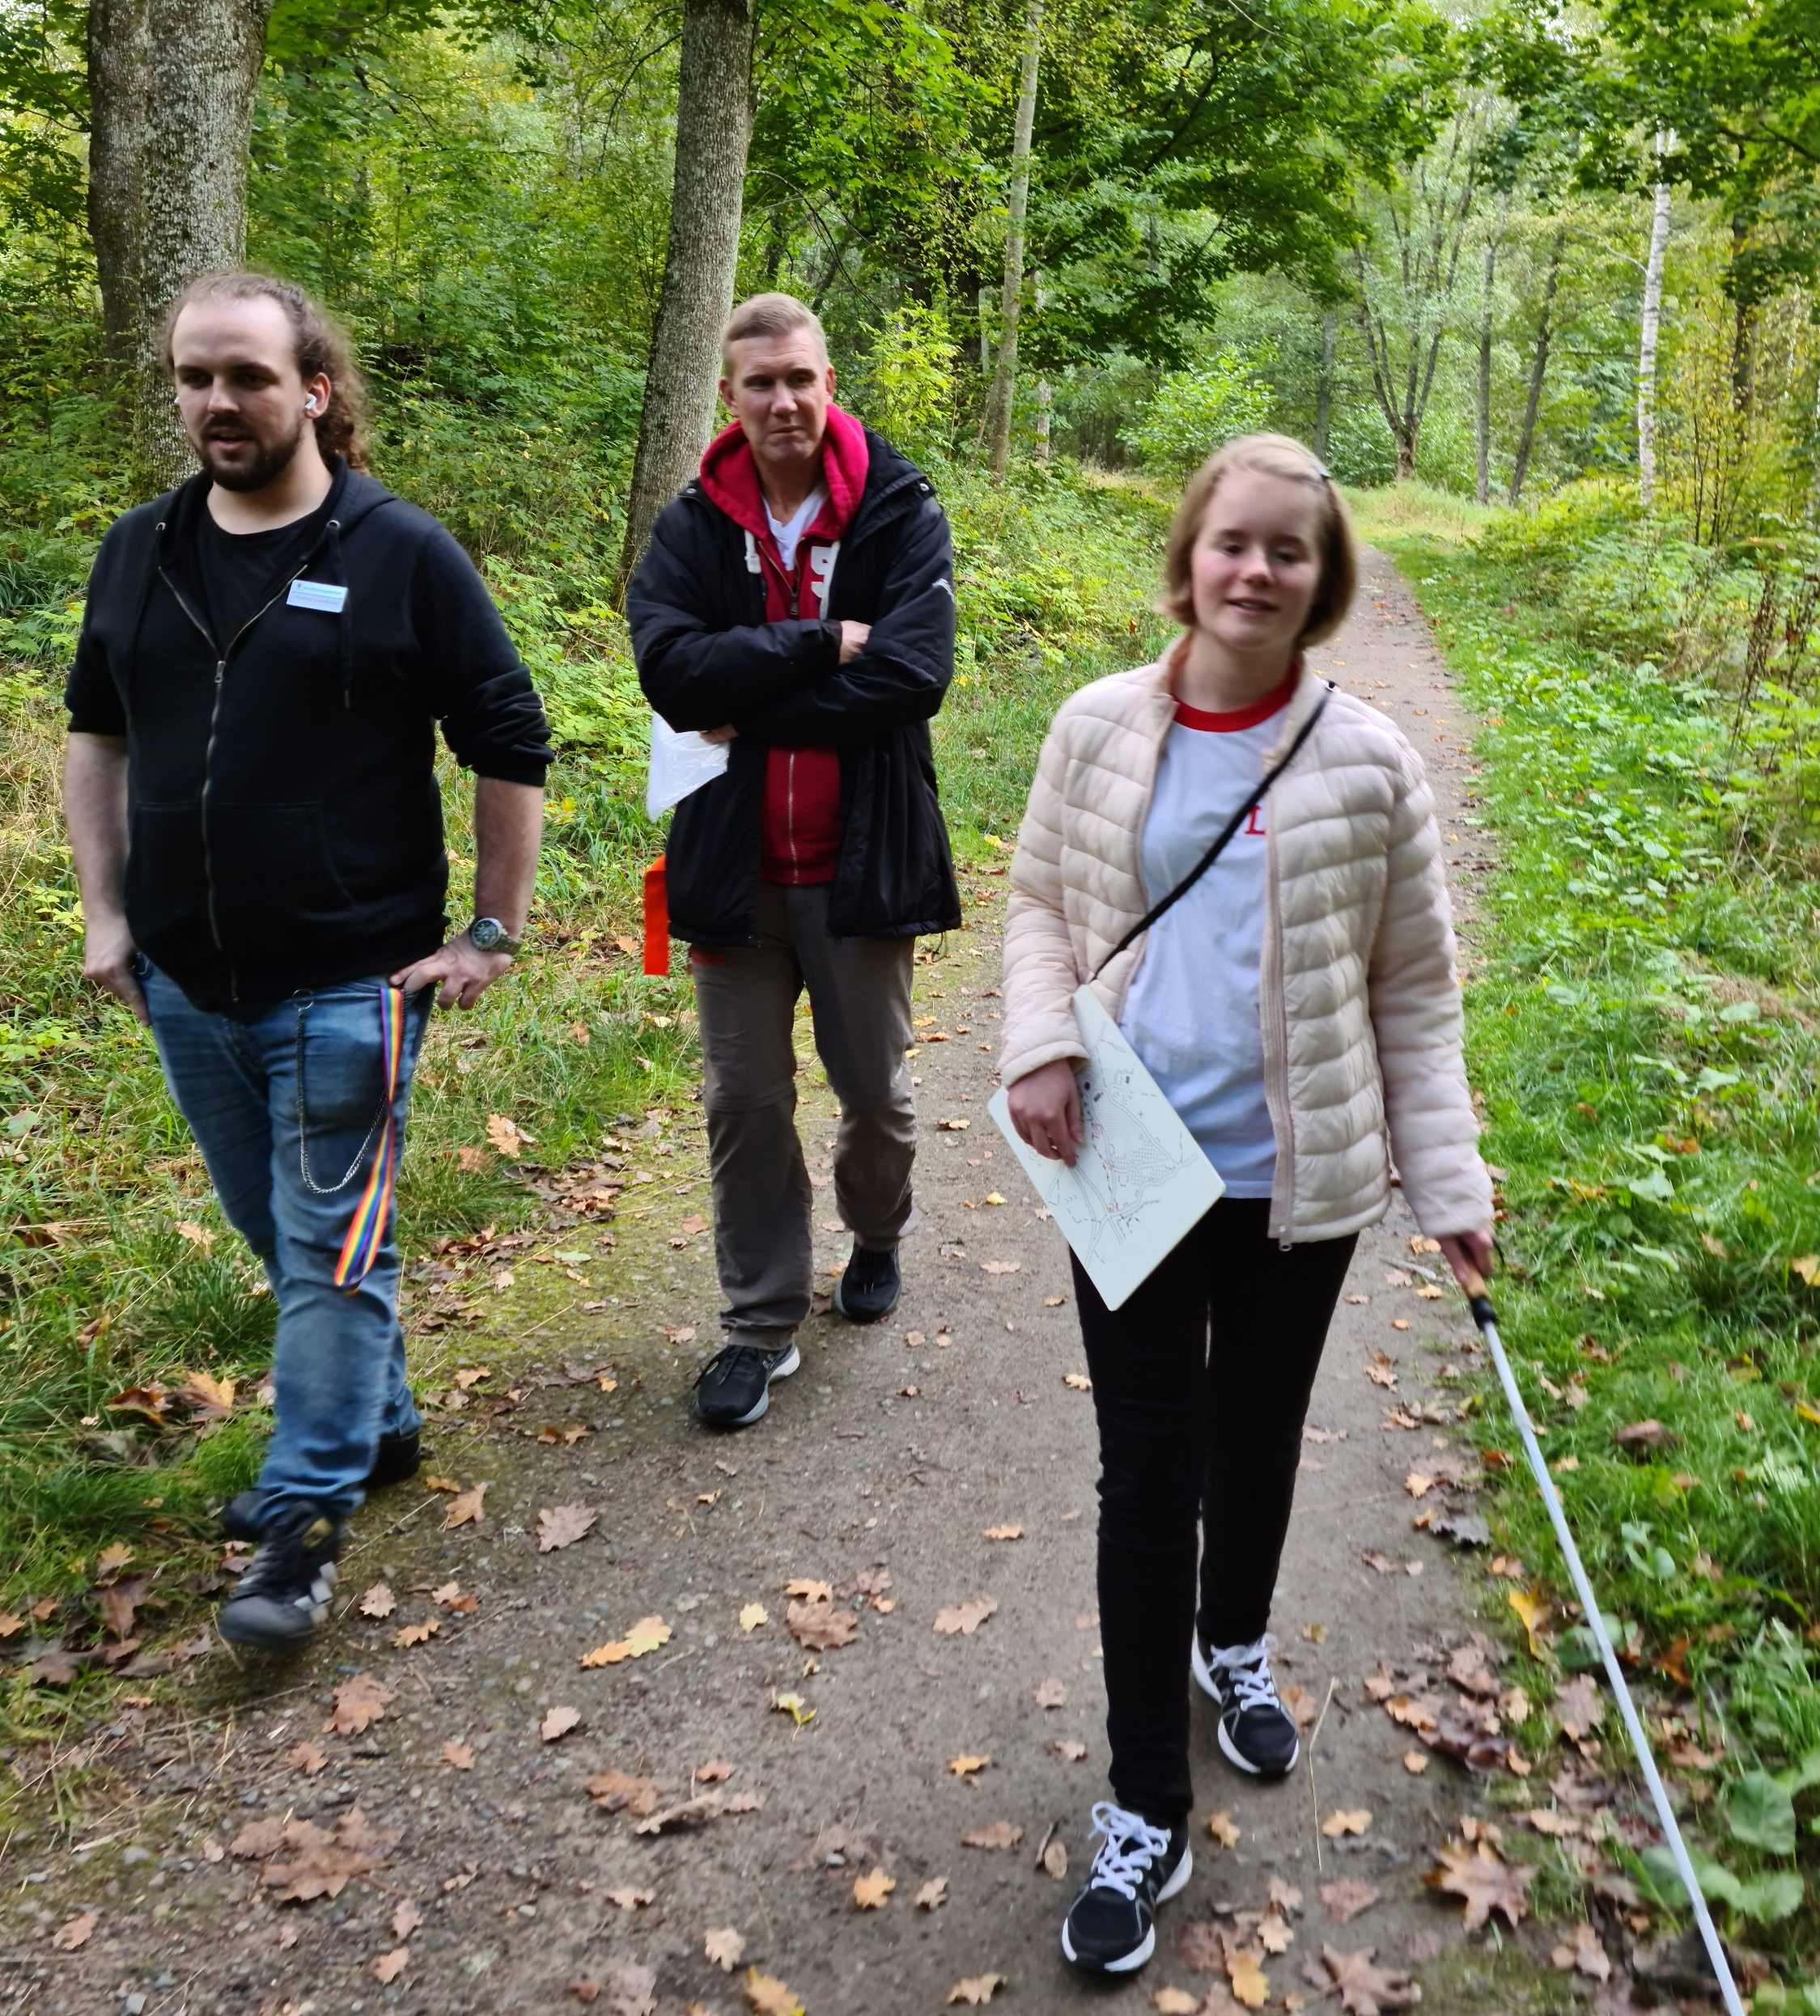
Education
Lectures with students who are becoming teachers in Physical Education.
How to make orienteering possible in school for both those with some vision left and for those who are blind.
Notes:
Lectures with students who are becoming teachers in Physical Education.
We are teaching how to make orienteering possible for both those with some visibility left and for those who are blind.
Some visibility left – use a regular copy machine and enlarge together until the pupil can see it!
For the blind ones, draw a map and print it on swell paper, then run it through a heating machine.

Slide 18
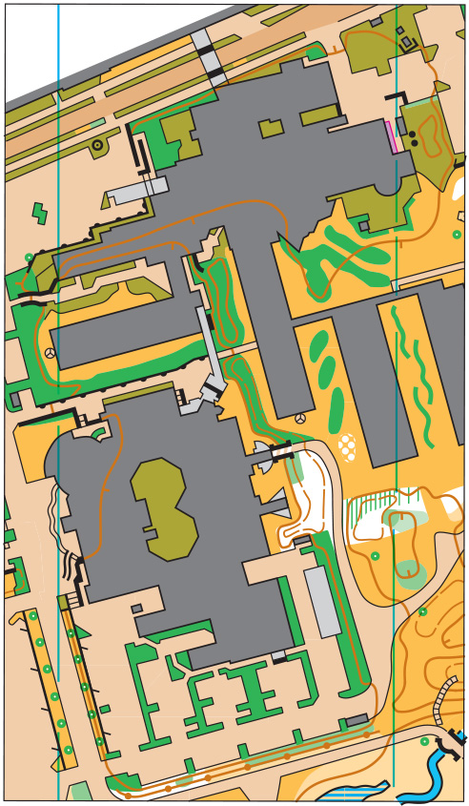
Enlarged simplified regular O-map
Same map –
different possibilities
Regular O-map
Notes:
Largest gruop of people with visually impairments can see something…

Slide 19
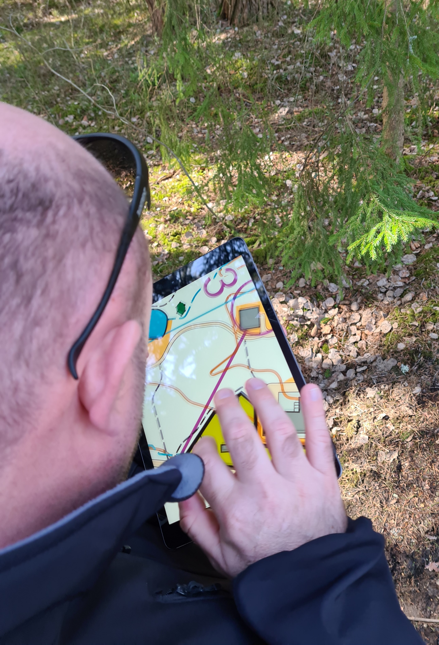
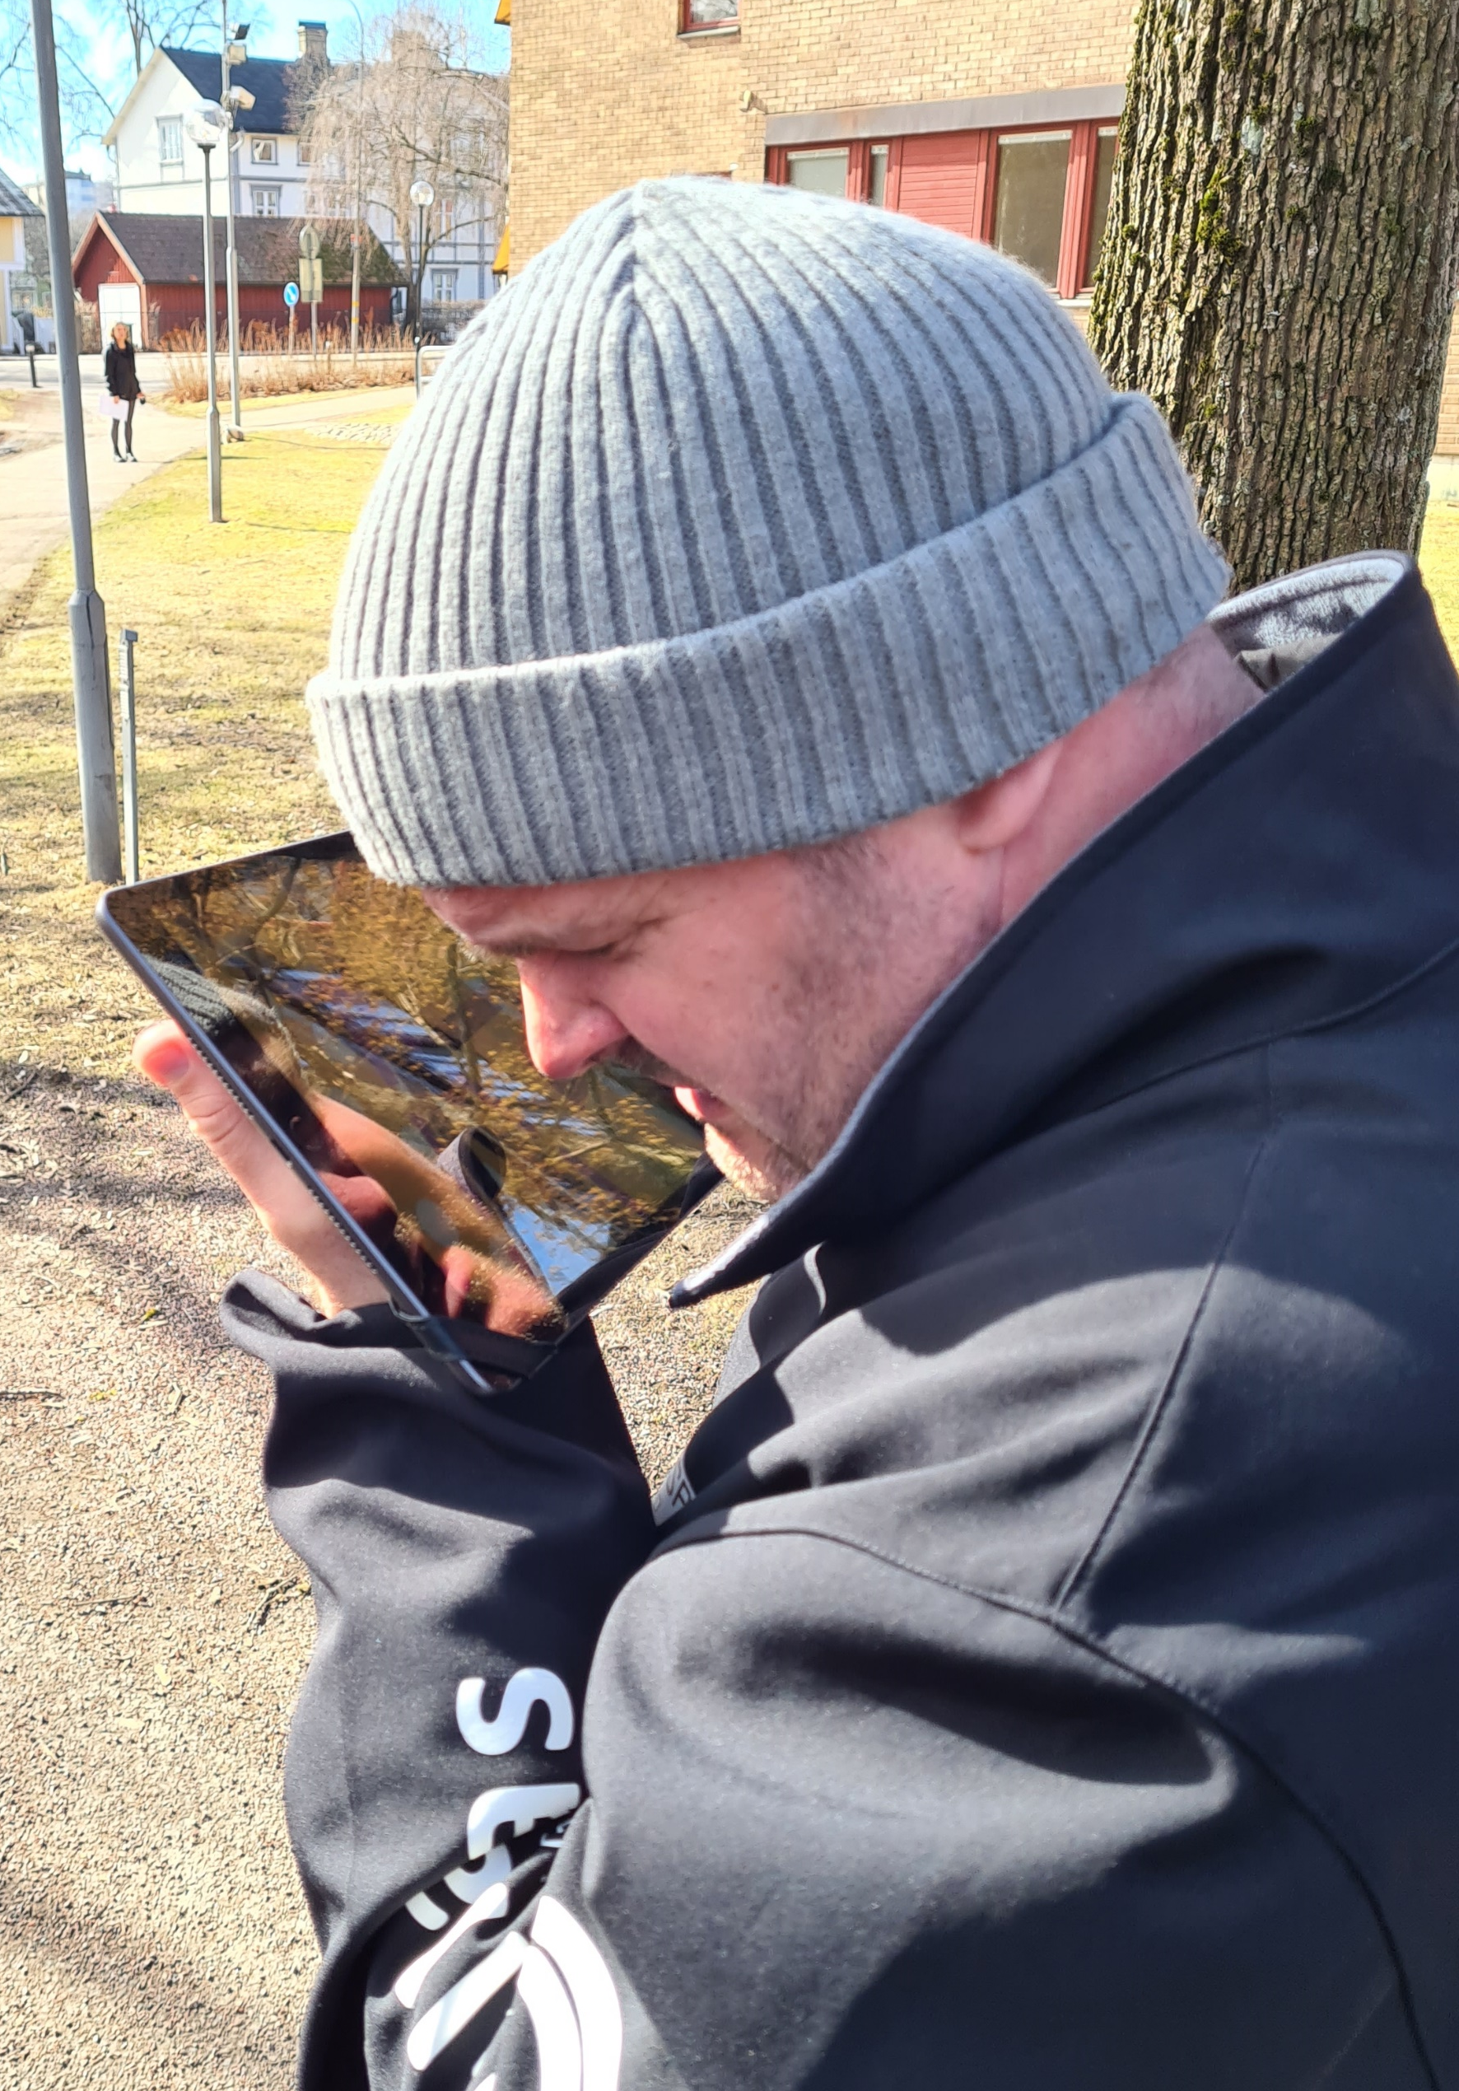
Notes:
2% vision

Slide 20
Future
The sport is spread in Sweden and other countries
”Orienteering for people with visual impairment” at the Paralympics!
Digitized map – from analog to digital map
Notes:
Digital map in an tablet – be able to scroll – the size of the ”terrain” is no longer an issue!
Tap on the tablet an you get the map symbols read out through your earphones!

Slide 22
Tak fordi du lyttede!
Kiitos että kuuntelit!
Takk for at dere hørte på!
Takk fyrir að hlusta!
Tack för att ni har lyssnat!
Tomas Yngström
+46(0)703810007
tomas.yngstrom@gmail.com
Projekt VägVisaren
projekt_vagvisaren

